Slide 1
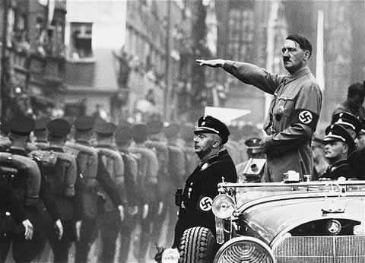
World War II
Outcome: Causes of World War II

Slide 2
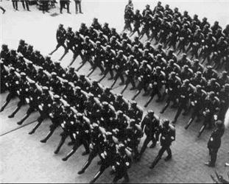
Causes of World War II
Underlying Causes of World War II
Nationalism (Review from WWI): Extreme pride in one’s nationality or country
Imperialism (Review from WWI): Taking of land/property
Militarism (Review from WWI): Building weapons or a strong military

Slide 3
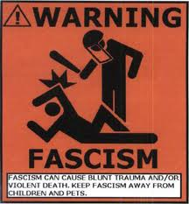
Causes of World War II
Underlying Causes of World War II
Fascism: a political philosophy, movement, or regime that exalts nation and often race above the individual and that stands for a centralized autocratic government headed by a dictatorial leader, severe economic and social regimentation, and forcible suppression of opposition

Slide 4
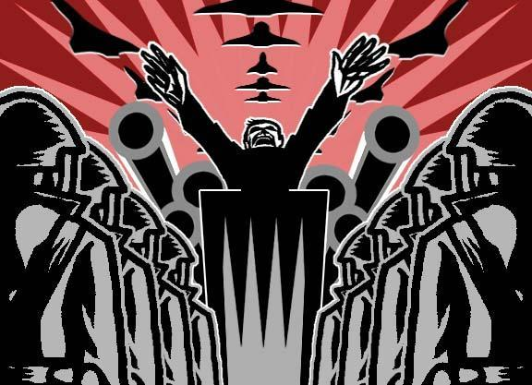
Causes of World War II
Totalitarian Dictatorships: Leaders who control all aspects of society
Each dictator took advantage of economic problems by:
Promising simple solutions to their nation’s problems
Rebuilding national pride (often using propaganda)
Providing scapegoats (targets for anger & blame)
Absorbing power, taking away individual rights, and crushing opposition (1 party; 1 ruler)

Slide 5
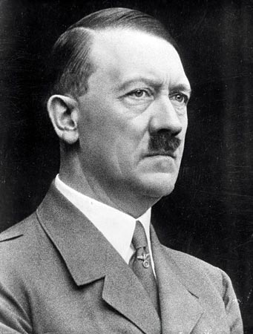
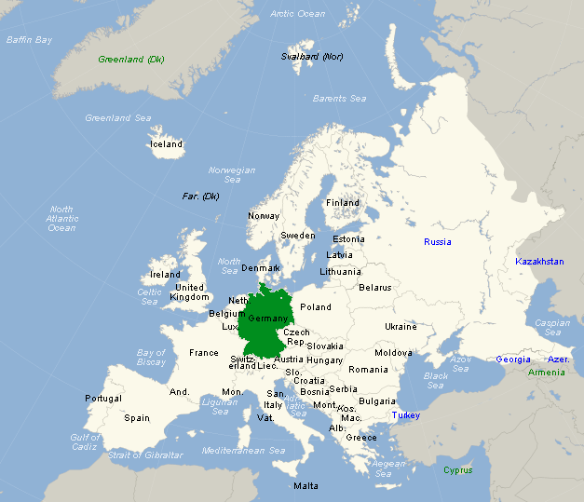
Adolf Hitler in Germany

Slide 6
Causes of World War II
Fascist Germany
Dictator: Adolf Hitler (Der Fuhrer or The leader)
Nazism is German Fascism
Goals:
Nationalism:
Wanted to rebuild Germany
Preached Vengeance against (4 hates)
Democracies (a weak & undisciplined form of gov’t)
Communism (a threat to Nazi growth)
November Criminals who signed the WWI Armistice
Jews (the source of all evil & problems in Germany)

Slide 7
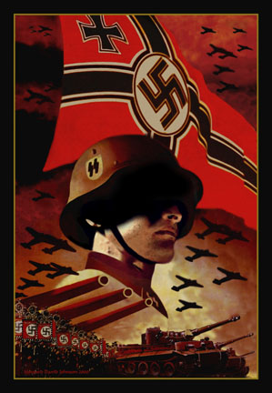
Causes of World War II
Fascist Germany
Imperialism:
A desire to unite all people of German ancestry (Blood & language)
“Lebensraum” (a desire for more living space) needed to build his empire he called The Third Reich
Militarism:
Defied the Treaty of Versailles & rebuild the army
Created the “Nazi War Machine”
Built #1 military in the world

Slide 8
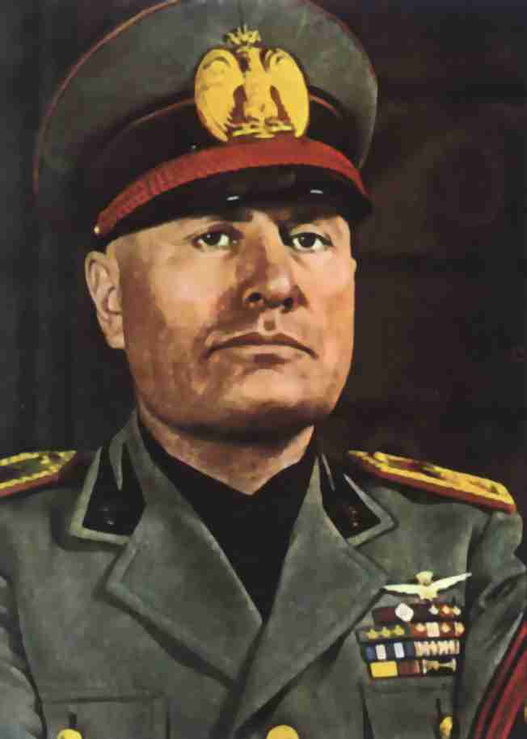
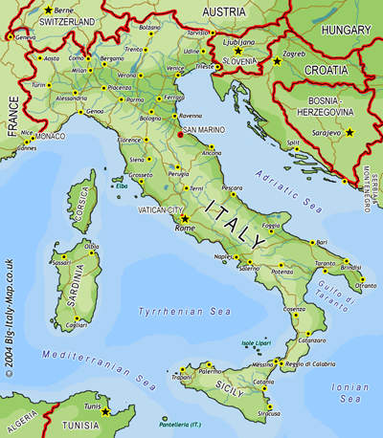
Benito Mussolini of Italy

Slide 9
Causes of World War II
Fascist Italy
Dictator: Benito Mussolini (Il Duce = The Leader)
Goals:
Nationalism:
Wished to rebuild the ancient Holy Roman Empire
Imperialism:
Felt betrayed by the Allies at the Treaty of Versailles Conference due to a promise of land for joining the Allies that was not kept
Wanted to control lands around the Mediterranean Sea;
“Mare Nostrum” = Our Sea
Militarism:
Formed the Rome-Berlin Axis (alliance) with Germany in 1936

Slide 10
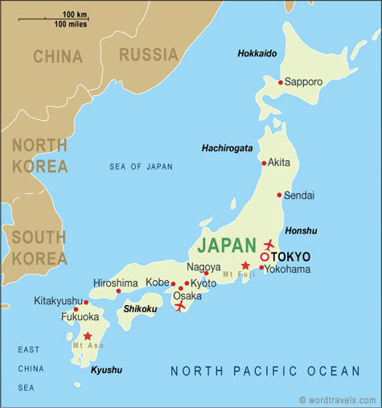
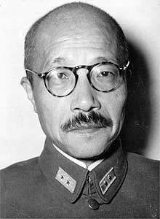
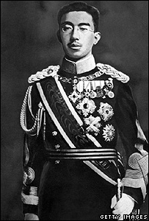
Hideki Tojo & Emperor Hirohito

Slide 11
Causes of World War II
Japan
Dictators:
Hideki Tojo: Military Leader & Prime Minister
Emperor Hirohito: Political & Spiritual figurehead
Goals
Nationalism:
Japan wanted to be #1 in Asia
Goal: Greater East Asian Co-Prosperity Sphere: name for power in Asia
Imperialism:
To be #1 in Asia, they needed oil and raw materials
Wanted China’s land (and others) to obtain oil and raw materials
Militarism:
Built up the strongest military regime in Asia
Soldier’s motto: “Death before Dishonor”

Slide 12
Causes of World War II
Others
Spain: Franco’s fascists won the Spanish Civil War
Soviet Union: Joseph Stalin took control of the communist nation
Germany, Italy, & Japan became known as the Axis Powers once the war began. AKA the Bad Guys!

Slide 13
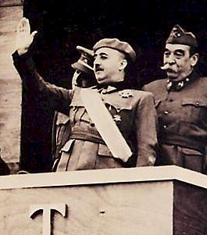
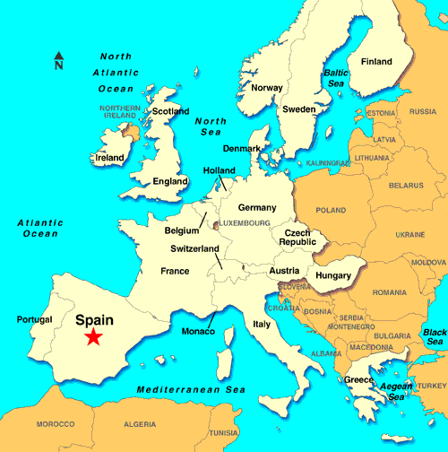
Francisco Franco of Spain

Slide 14
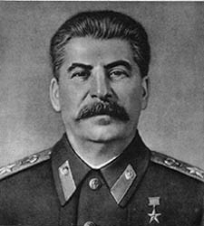
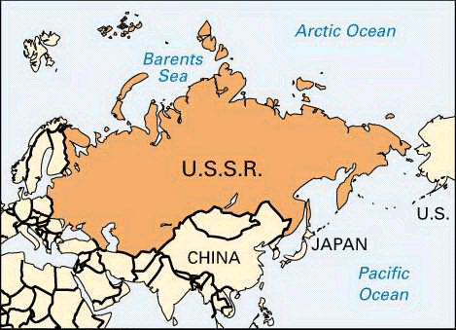
Joseph Stalin in The Soviet Union

Slide 15
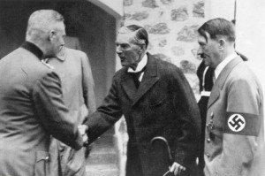
Causes of World War II
Poor Decisions were made by the powerful democracies
France & Great Britain adopted a policy of appeasement
The League of Nations would prove ineffective; lacked a military
U.S.: Isolationism & Depression kept our focus on U.S. concerns; once aggression began we claimed to be neutral

Slide 16
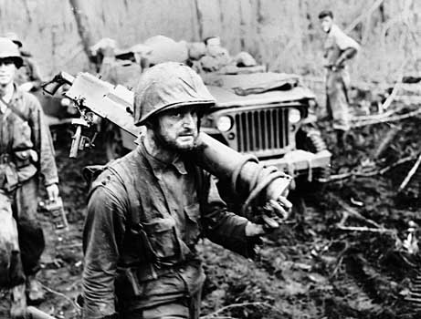
Causes of World War II
Equation:
Nationalism + Imperialism + Militarism = Aggression
Extreme Aggression = War!

