Slide 1
Essential Question:
Why was exploration and colonization important in the development of Europe and the world?
Standards:
SS6H6a. Identify the causes of European exploration and colonization; include religion, natural resources, a market for goods, and the contributions of Prince Henry the Navigator.
SS6H6b. Trace the empires of Portugal, Spain, England, and France in Asia, Africa, and Americas.
SS6H6d. Explain the impact of European empire building in Africa and Asia on the outbreak of WWI.
Notes:
Instructional Approach(s): The teacher should introduce the essential question and the standards that align to the essential question.

Slide 2
What does exploration mean? What about colonization?
With a seat partner, describe an example of exploration
[could possibly be from a movie].
Describe an example of colonization [could possibly be from a movie]
https://www.youtube.com/watch?t=1&v=xFo-pkIRvwc
Notes:
Instructional Approach(s): Have students turn to a partner and discuss the question on the slide. Partners can be determined by the students or the teacher can provide more specific directions such as turn to the person directly in front/behind you or to the right/left of you, etc. It may be necessary to have a group of three if you have an uneven number of students. Do not allow more than 30 seconds to 1 minute of discussion time. The teacher should be walking around listening and redirecting discussions as needed. The teacher can briefly discuss student responses. The YouTube video linked at the bottom may be used as an activator for the lesson or the next slide comparing the movie Avatar may be used as an activator.

Slide 3
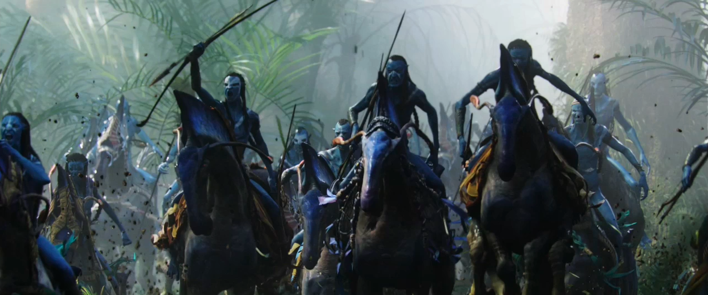
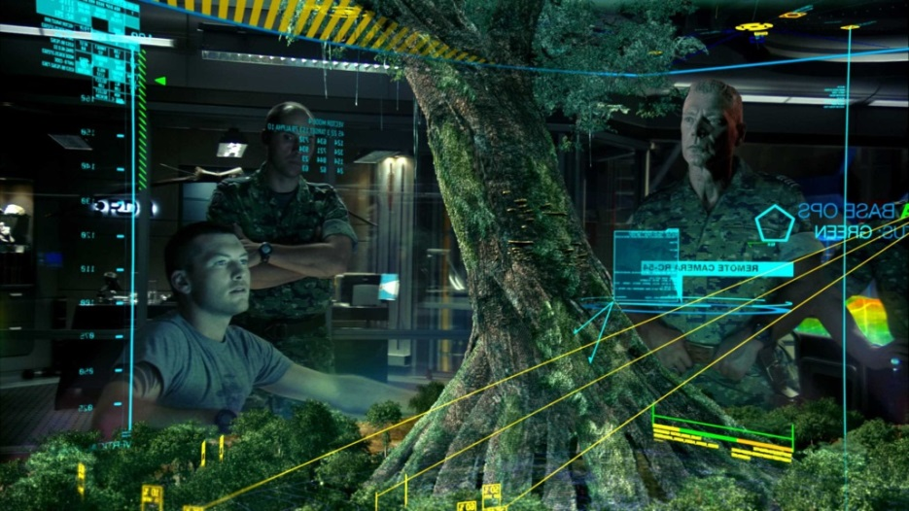
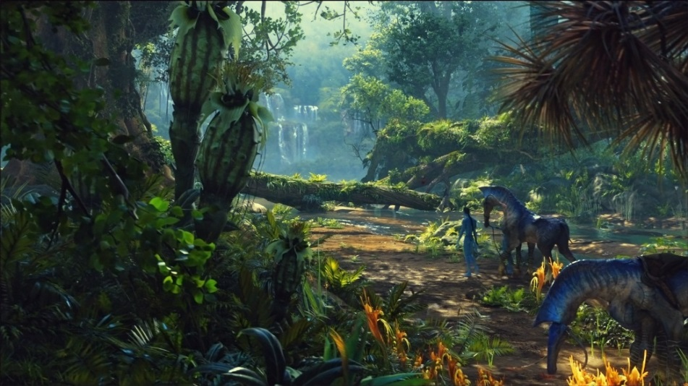
How many of you have seen the movie Avatar? How is it an example of exploration and colonization?
https://www.youtube.com/watch?v=d1_JBMrrYw8
Notes:
Instructional Approach(s): The teacher should pose the question to the class and ask for volunteers or call on students to respond. The teacher may want to get a student to give a 30 second summary of the movie, or watch the movie trailer linked on the slide.

Slide 4
What motivated the explorers to explore?
Notes:
Instructional Approach(s): The teacher should pose the question to the class and ask for volunteers to answer the question. Chances are, many students already know the reasons for exploration.

Slide 5
Use your graphic organizer to summarize the important information from the lesson
Notes:
Instructional Approach(s): The teacher should give each student a copy of the European Exploration & Colonization Graphic Organizer [linked on the curriculum map] to record important information during the lesson.

Slide 6
Spices
In the 1400s, there was no refrigeration. To prevent meat from spoiling, people drowned their meat in salt to preserve and dry it (like beef jerky). They also used a lot of spices like pepper to cover up the taste of the salted or spoiled meat.
Notes:
Instructional Approach(s): The teacher should present the information on the slide.

Slide 7
Spices
Unfortunately, the natural resources used to make these spices could not be found in Europe. They were only found in Asian countries. It was very difficult to get the spices from Asia to Europe over land so spices became very expensive.
Notes:
Instructional Approach(s): The teacher should present the information on the slide.

Slide 8
Spices
Several European rulers finally decided to try to find a new route-a sea route. If a country could find a way to get these valuable spices to Europe, the rulers would be very rich.
Notes:
Instructional Approach(s): The teacher should present the information on the slide.

Slide 9
What you need to know about Spices:
Europeans needed a sea route to get spices cheaper.
Notes:
Instructional Approach(s): The teacher should present the information on the slide while the students summarize the information on their graphic organizer.

Slide 10

Gold
Gold was another natural resource that explorers were looking for. However, they really wanted wealth and fame, not just physical gold.
Notes:
Instructional Approach(s): The teacher should present the information on the slide.

Slide 11
What you need to know about gold:
The natural resource Gold would bring wealth and power to whatever country found it.
Notes:
Instructional Approach(s): The teacher should present the information on the slide while the students record the important information on their graphic organizer.

Slide 12

Larger Empires
Some European rulers, especially the King of Spain and the King of Portugal, wanted to claim as much land as they could. They wanted to take all of the natural resources from the new land and use the people that lived there as slaves to do their work.
Notes:
Instructional Approach(s): The teacher should present the information on the slide.

Slide 13
What you need to know about larger empires:
Countries would do anything to expand their empire to new places. New places meant new markets for their goods and more valuable natural resources.
Larger empire = More power
Larger empire = More money
Notes:
Instructional Approach(s): The teacher should present the information on the slide while the students record the important information on their graphic organizer.

Slide 14

Spread Religion [Christianity]
In the late 1400s, there was only one religion in Europe, Christianity. The European rulers were very religious. They wanted to convert everyone to Christianity.
Notes:
Instructional Approach(s): The teacher should present the information on the slide.

Slide 15
What you need to know about spread Christianity:
Europeans wanted to spread their religion [Christianity] to the new places they explored.
Notes:
Instructional Approach(s): The teacher should present the information on the slide while the students record the important information on their graphic organizer.

Slide 16

Often the three “Gs” are used to explain the reason for European Exploration:
Gold
God
Glory
Notes:
Instructional Approach(s): The teacher should present the information on the slide.

Slide 17
Advances in Equipment
Notes:
Instructional Approach(s): Transition slide to the next concept of exploration

Slide 18
Prince Henry the Navigator Task
Notes:
Instructional Approach(s): The teacher should facilitate the literacy task “Prince Henry the Navigator” linked on the curriculum map.

Slide 19
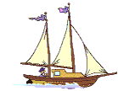
Advances in Equipment
Advances in equipment and sailing ships made long voyages possible.
Prince Henry the Navigator was a Portuguese prince and naval commander who founded a school of navigation for sailors.
Prince Henry the Navigator paid for expeditions and employed mapmakers to create detailed maps of new explorations.
Prince Henry’s shipbuilders developed a smaller, light sailing ship
Notes:
Instructional Approach(s): The teacher should present the information on the slide while the students summarize the important information on their graphic organizer.

Slide 20
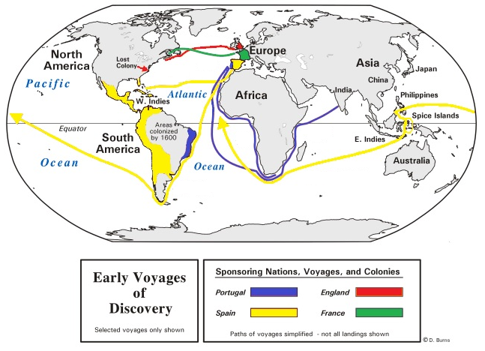
European Exploration Routes
Notes:
Instructional Approach(s): Transition slide to the next concept

Slide 21
Use the European Empires Student Map to record the different routes
Notes:
Instructional Approach(s):The teacher should give each student a copy of the European Empires Map [linked on the curriculum map] to record the different routes. You may want students to label the continents before you record the different routes.

Slide 22
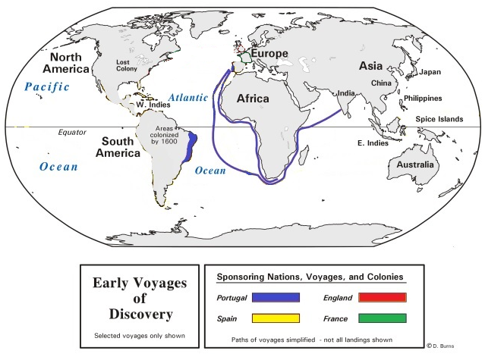
Portugal’s Explorations
Notes:
Instructional Approach(s): The teacher should present the slide showing Portugal’s exploration route. Students should complete their map as close to the map shown as possible.

Slide 23
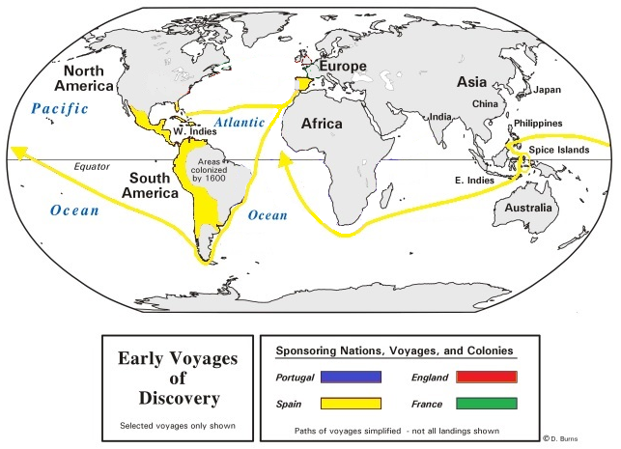
Spain’s Explorations
Notes:
Instructional Approach(s): The teacher should present the slide showing Spain’s exploration route. Students should complete their map as close to the map shown as possible.

Slide 24
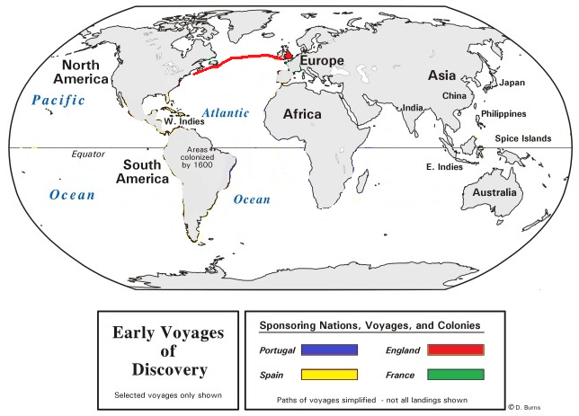
England’s Explorations
Notes:
Instructional Approach(s): The teacher should present the slide showing England’s exploration route. Students should complete their map as close to the map shown as possible.

Slide 25
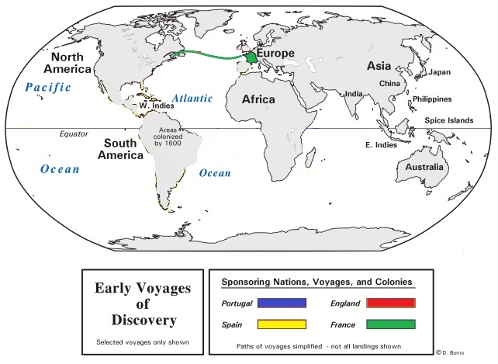
France’s Explorations
Notes:
Instructional Approach(s): The teacher should present the slide showing France’s exploration route. Students should complete their map as close to the map shown as possible.

Slide 26
What is an empire?
An empire is a group of countries or regions that are controlled by one ruler or one government.
Can you think of any examples?
Notes:
Instructional Approach(s): The teacher should pose the question to the class and ask for volunteer responses. The teacher might use examples such as Star Wars [Galactic Empire] or Star Trek [Romulan Empire]. The students may be able to come up with several examples from video games.

Slide 27
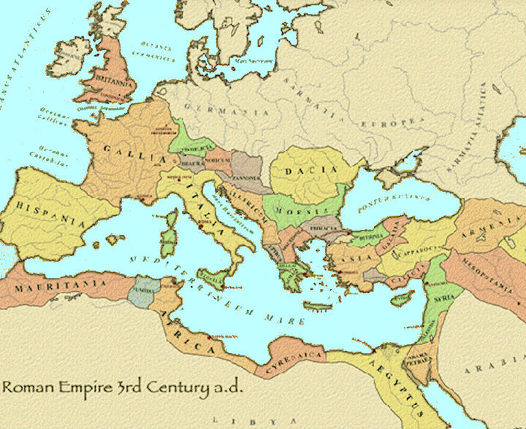
Look at the Roman Empire below as an example.
Notes:
Instructional Approach(s): The teacher should use the slide to illustrate a empire.

Slide 28
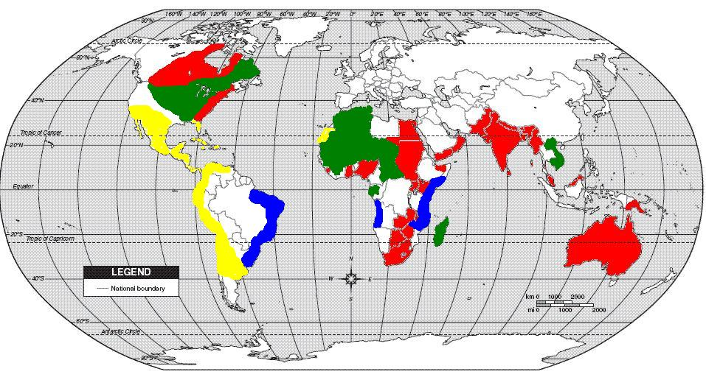
The countries of Portugal, Spain, England, and France led the exploration and colonization movement and built individual empires across the Americas, Africa, Asia, and Australia.
Notes:
Instructional Approach(s): The teacher should present the information on the slide.

Slide 29
European Empires Map Activity
Notes:
Instructional Approach(s): The teacher should facilitate the Europeans Empires Map Activity in which the students color the European Empires on their own map.

Slide 30
Use the European Empires Student Map to record the different empires
Notes:
Instructional Approach(s): The students should use the map from the “routes” slides to identify the European Empires during colonization.

Slide 31
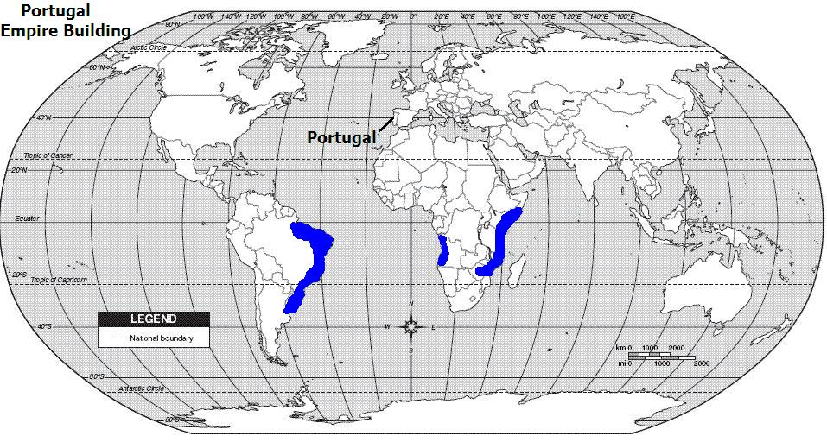
Empire of Portugal
Notes:
Instructional Approach(s): The students should color their map to match the one shown on the slide as close as possible. The teacher should walk around to ensure students are attempting to color the empire in correctly.

Slide 32
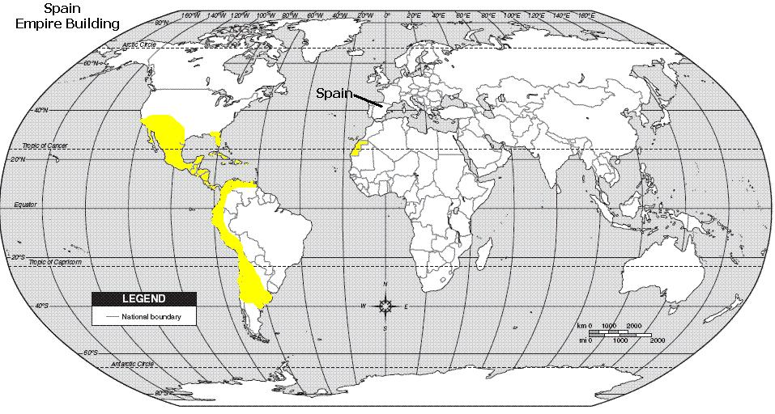
Empire Spain
Notes:
Instructional Approach(s): The students should color their map to match the one shown on the slide as close as possible. The teacher should walk around to ensure students are attempting to color the empire in correctly.

Slide 33
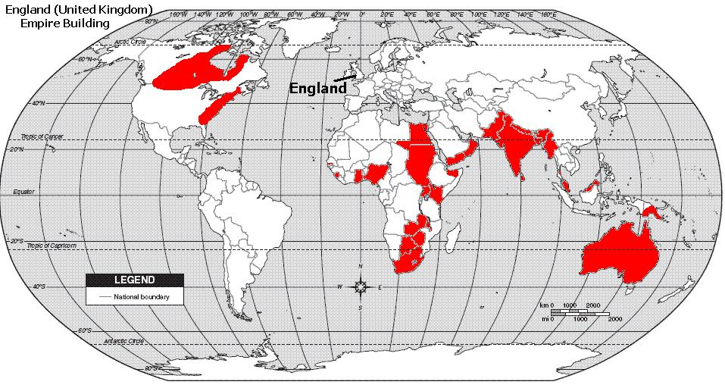
British Empire
[England or United Kingdom]
Notes:
Instructional Approach(s): The students should color their map to match the one shown on the slide as close as possible. The teacher should walk around to ensure students are attempting to color the empire in correctly.

Slide 34
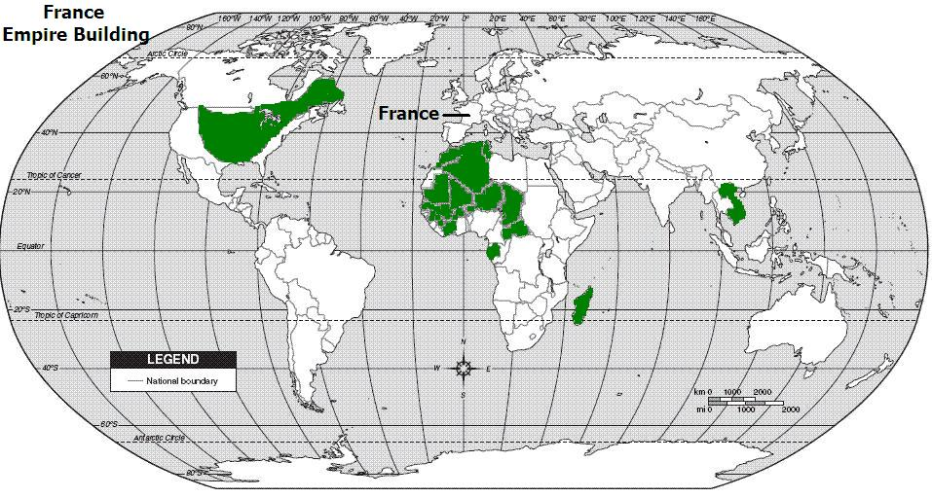
Empire of France
Notes:
Instructional Approach(s): The students should color their map to match the one shown on the slide as close as possible. The teacher should walk around to ensure students are attempting to color the empire in correctly.

Slide 35
Look specifically at Africa and North America. What do you think happened to the people already living in these areas?
Notes:
Instructional Approach(s): The teacher should pose the question to the class and ask for a few student responses. See page 131 in the Georgia Experience Carole Marsh workbooks.

Slide 36
Summarizing Strategy
You are a European Explorer. Select an empire and describe where you explored, why you explored, and the possible effect your exploration had on the people there.
Notes:
Instructional Approach(s): Each student should complete the summarizer. The teacher should use the summarizer to determine the level of student mastery and if differentiation is needed.

