Slide 1
Why did North Carolina and South Carolina Split?

Slide 2
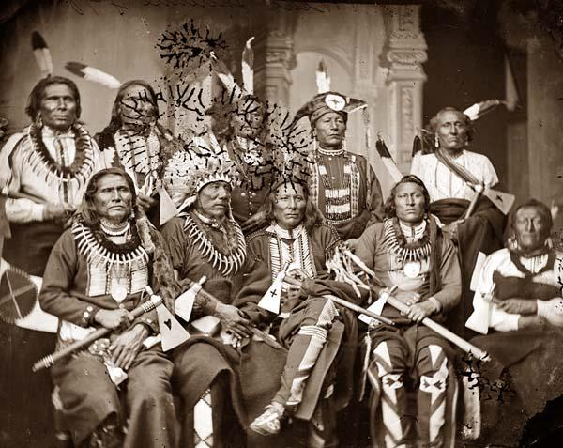
Name three problems within North Carolina in the years after 1700?
Religious groups in the colony were at odds
Native Americans and settlers warred with one another
Pirates roamed the waters off the coast

Slide 3
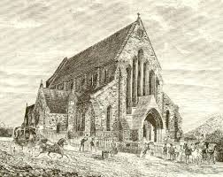
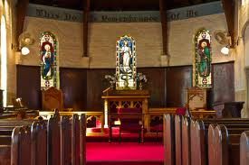
What was the official tax supported church of Carolina?
Anglican Church (Church of England)
BUT… the Proprietors had done nothing about setting up an Anglican Church in the colony

Slide 4
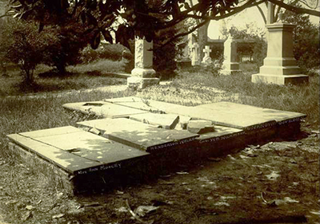
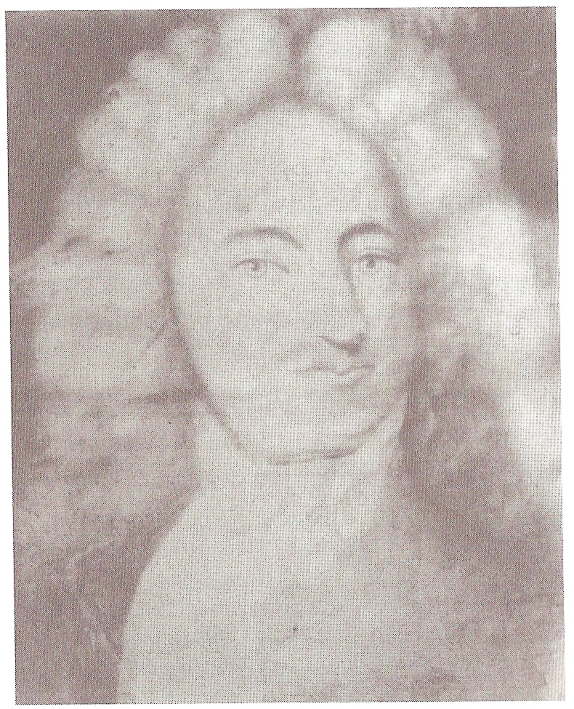
What was the first Church law in North Carolina?
Henderson Walker became Governor in 1699
He believed that the Anglican Church should take its rightful role in the colonies
He passed the Vestry Act to put the Anglican Church above all others

Slide 5
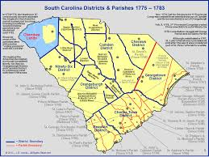
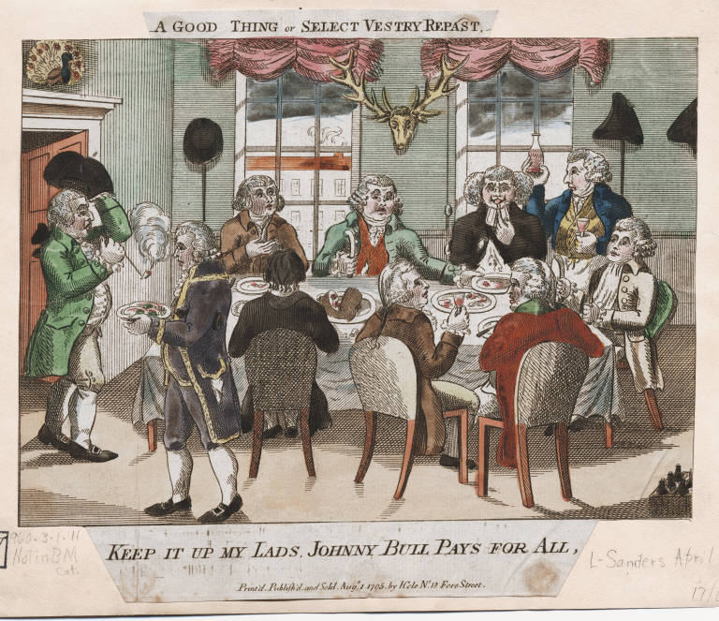
What three items did this law call for?
Laying out parishes (districts)
Organizing vestries (church board)
Tax to support clergymen

Slide 6
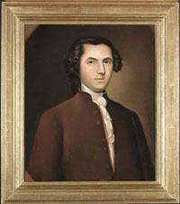
Who became the first Governor of North Carolina?
Edward Hyde
Struggle among religious groups convinced Proprietors to have a stronger government in the North
Governor independent from the South

Slide 7
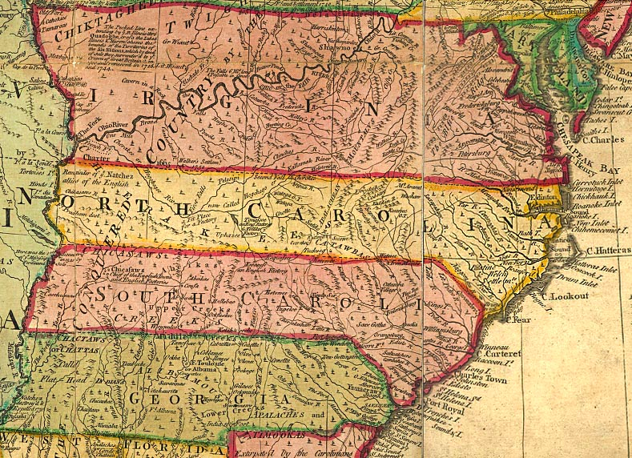
What date marks the separation of North Carolina and South Carolina?
May 9, 1712
Edward Hyde took oath of office as the first governor

Slide 8
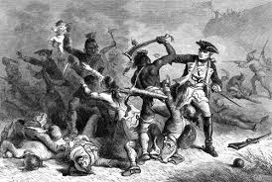
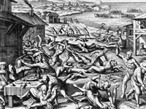
What were the Tuscarora Indians upset about?
Being cheated by colonial traders
Resented losing their land
Forced into slavery

Slide 9
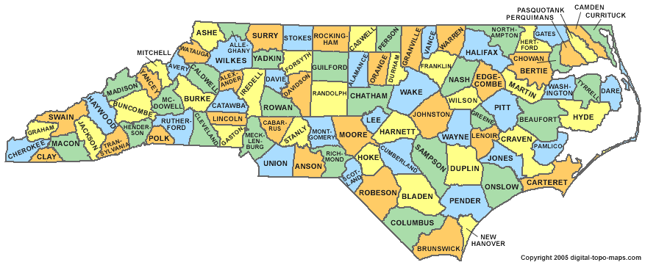
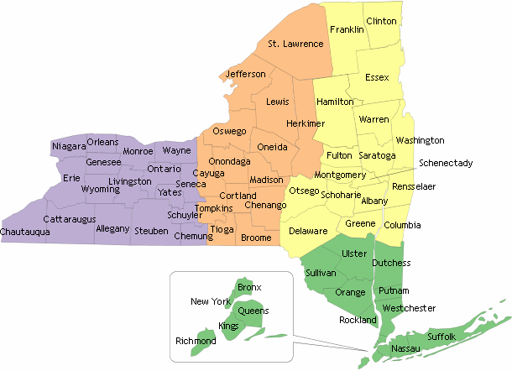
Following the Tuscarora War were did the surviving Indians leave to?
Colonists would seek revenge for Tuscarora attacks
Sold many of them into slavery
Those who escaped, fled to New York

Slide 10
Towns that had 60 or more families were allowed to send a delegate to the colonial Assembly, what were these towns called?
BOROUGH TOWNS

