Slide 2
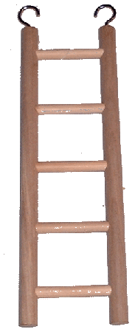
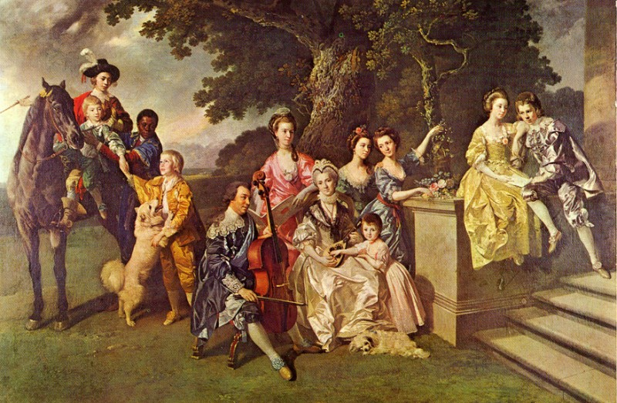
The Colonial Social LADDER
Use the ladder to help you take notes about society in the 1770’s and today.
NC SCOS:
1.07
www.lennoxhonychurch.com/.../Young%20Family.jpg

Slide 3
Who was at the bottom of the ladder?
SLAVES :
A person who works against their will for life

Slide 4
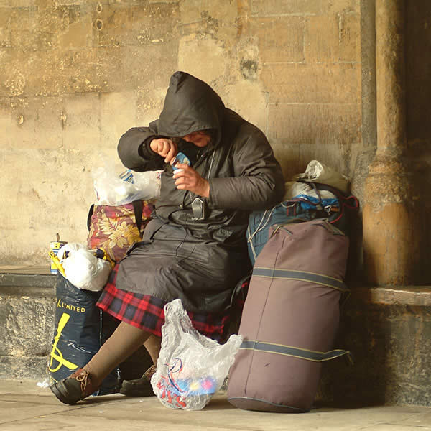
HOW does this relate t0 2014?
Today, these people are the:
Very Poor
Homeless
No education
$0

Slide 5
Just above a slave is an indentured servant (in the same space) .
INDENTURED SERVANTS are hired servants that work for a specific period of time.
They are socially
higher than a slave but still on the lowest level.

Slide 6
How does this relate to 2014?
These people are working in order to better themselves
Examples would be:
College scholarship for an athlete
Someone who joins the military.
Student Teacher

Slide 7
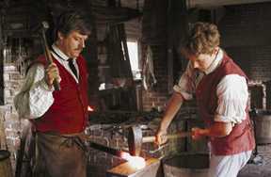
Next are APPRENTICES or trade students
A person who learns a skill or trade from a master craftsman.

Slide 8
In 2014 these people are…
WORKING POOR: they work for minimum wage. They can also be trade students at a local community college.
WHY IS HIS SHOW CALLED THE APPRENTICE?
HOW DOES IT RELATE TO
THE DEFINITION?
WHAT CURRENT JOBS DO YOU APPRENTICE AT TODAY?

Slide 9
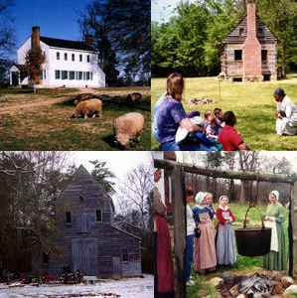
YEOMAN= AVERAGE
Small Family Farmers
Farms produced enough for the family and only a small amount to sell or trade
Usually sold/traded specific items like eggs, wool, apples, milk, butter.
From:
Latta Plantation Charlotte, NC

Slide 10
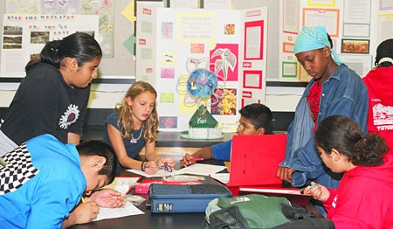
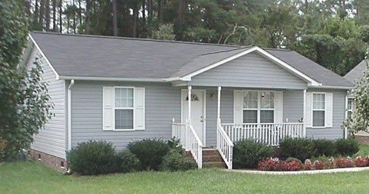
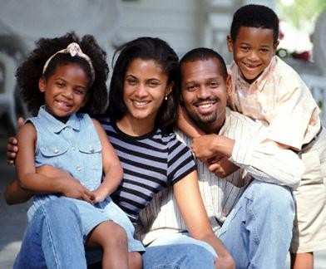
HOW does this relate t0 2014?
Today, these people are the:
The Middle Class: have average status, income, education, tastes, etc.

Slide 11
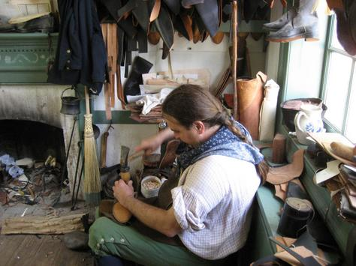
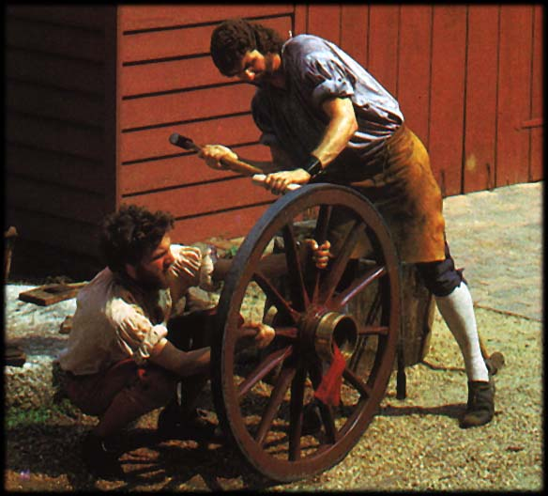
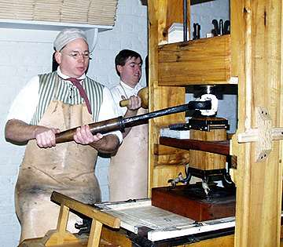
ARTISANS = CRAFTSMEN &
Minor Professionals
Crafts people or
professionals
Bosses for apprentices.
Examples: blacksmith, leather toolers, silversmiths, builders, furniture makers.

Slide 12
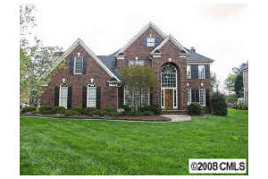
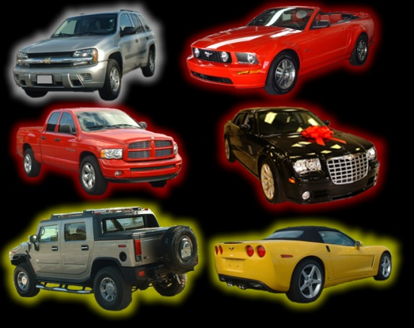
Who are these people TODAY?
Any Guesses????
Hints
Radiologist
Anesthesiologist
Veterinarian
Marketing director
Psychologist
Stock Broker
UPPER MIDDLE CLASSES
Usually have more than 4 years of college or are successful inventors.

Slide 13
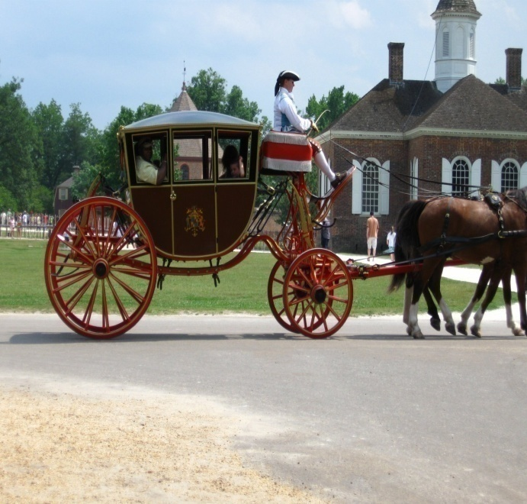
Only 2% are the…
$$$$$$$GENTRY$$$$$$$
UPPER CLASS, HIGHLY EDUCATED, WEALTHY PROFESSIONALS

Slide 14
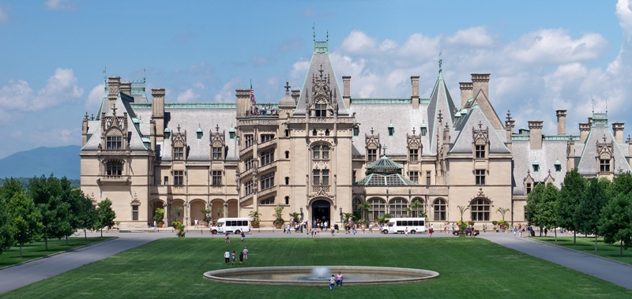
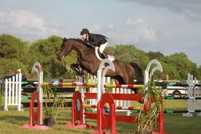
The Upper Class
The #’s are the same. LESS THAN 2% OF THE POPULATION IS WEALTHY.

Slide 15
Right-side Assignment: Colonial Social Pyramid
On pg. 55, you will create a pyramid.
Divide it into 6 sections (one for each class)
-Gentry (Top)
-Slaves (Bottom)
For each colonial class, I want you to draw an illustration demonstrating who those people were.
Color is a MUST!!!!

Slide 16
Right-side Assignment: Colonial Social Pyramid
On pg. 55, you will create a pyramid.
Divide it into 6 sections (one for each class)
-Gentry (Top)
-Slaves (Bottom)
For each colonial class, I want you to draw an illustration demonstrating who those people were.
Color is a MUST!!!!

