Slide 2
Native Americans in the North Carolina Region
Copy all the notes onto your paper. This will help you study and for other assignments.
These notes will need to be put in your notebook on pg. 16
NC SCOS 1.02

Slide 3
Beringia-Land Bridge
Copy this chart down on pg. 16 of your interactive notebook!
Make sure to leave enough room in the boxes to take notes!!
Paleo Indians
Archaic Indians
Woodland Indians
Mississippian Indians

Slide 4
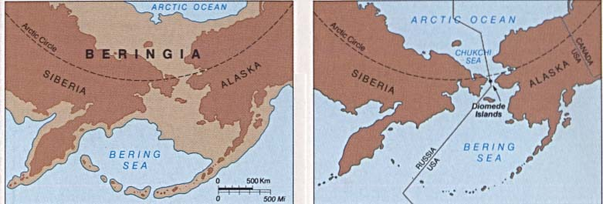
BERINGIA- LAND BRIDGE
40,000–15,000 B.C. People migrate to North America from Asia by way of the Bering Land Bridge.
NC Museum of History & National Parks Service Map

Slide 5
PALEO INDIANS
Paleo= very old; before 10,000 BC
Nomadic Hunters.
They used simple stone tools with NO modifications
www.historyfor kids.com
Hunted large animals & followed herds.
Picture from Historyforkids.com

Slide 6
ARCHAIC INDIANS
1. Semi-nomadic hunters; moved with the seasons.
4. Started to develop ways to improve hunting and their way of life.
2. May have believed in an afterlife once they passed away.
3. Used polished or shaped stone tools.

Slide 7
WOODLAND INDIANS
They lived in permanent villages.
2. Used bow and arrow
3. Hunters & Gatherers
used what was in the area for food and housing.
4. A strong belief in the afterlife.
Look at the picture below does this look like what you thought it would?
http://www.eliwhitney.org/woodland/images/village.gif

Slide 8
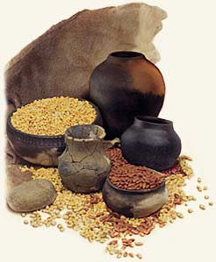
MISSISSIPPIAN INDIANS
Lived around ceremonial centers. These are on mounds and important to their religion.
Farms and agriculture were their sources of food.
They enjoyed athletics and “free” time.
They left evidence of life and artifacts in North Carolina
http://bama.ua.edu/~alaarch/clipart/indian05.jpg and http://www.missionsanluis.org/_images/apalacheeProvinceImage.jpg

Slide 9
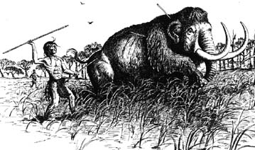
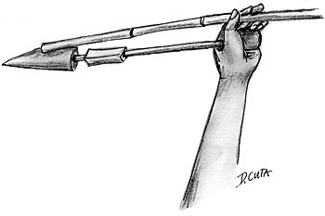
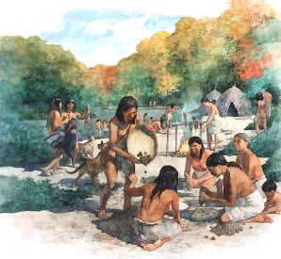
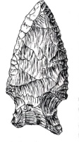
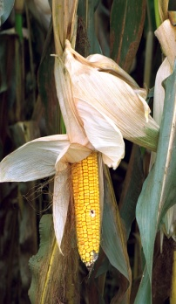
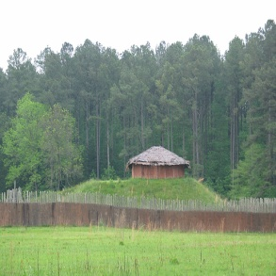
Archaic Indians: seasonal travel & discover the territory
Woodland Indians: villages begin and people settle down in smaller areas
Mississippi Indians: tribes begin and differences develop. Lots of evidence is left in order to study these people.
Paleo Indians: use the land bridge to travel
BC 10,000 5,000 1,000 500 1,000 1,300 1,500 2,000 AD

Slide 10
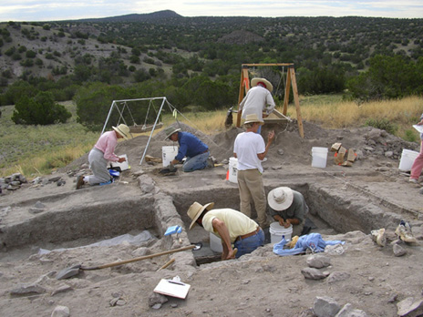
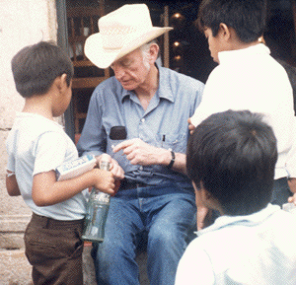
How do we know all this?????
Anthropologist:
Scientist who studies human culture (people) and how cultures influence each other.
Archaeologist:
Scientists who unearth and study items left behind by ancient peoples.
gazette.gmu.edu/images/BCexcavationssummer05.jpg
http://i158.photobucket.com/albums/t93/thawk24/milesatwork.gif

