Slide 3
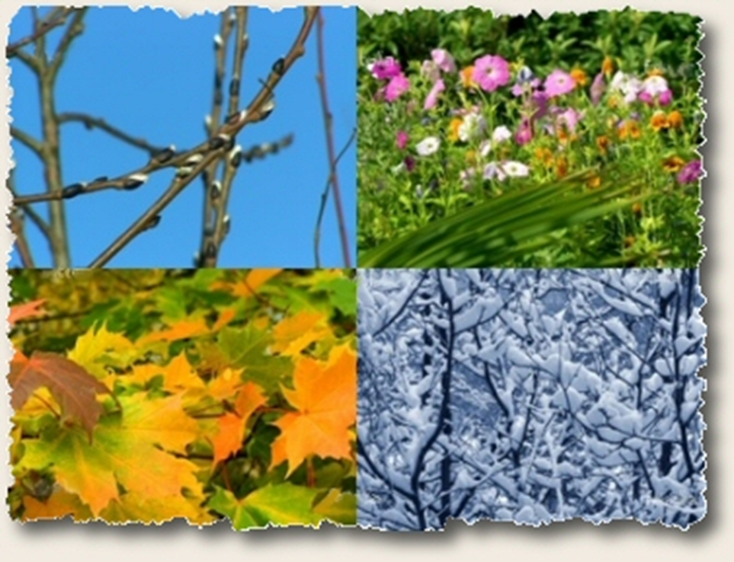
Climate and Weather

Slide 4
I. Climate
Climate is the main kind of weather that a region enjoys over an extended period of time
NC is in the Sun Belt
-Warm-weather Southern states

Slide 5
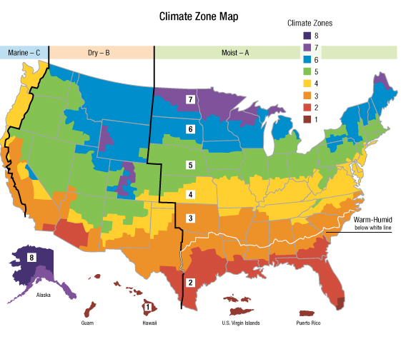

Slide 6
II. Location
Important factor in climate
Closer to equator = warmer the climate
Short winters
Longer growing season

Slide 7
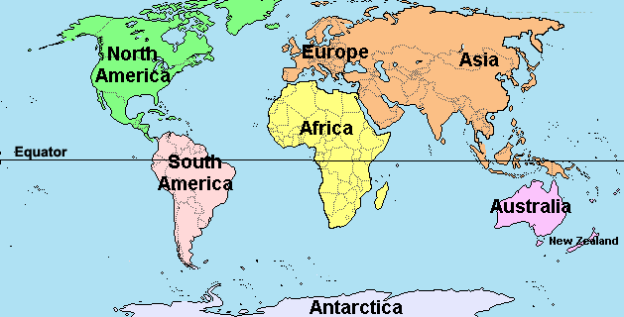

Slide 8
III. Atlantic Ocean
Makes the air more moist
Water holds heat and warms the air
Gives NC warm, humid summers and cool, damp winters

Slide 9
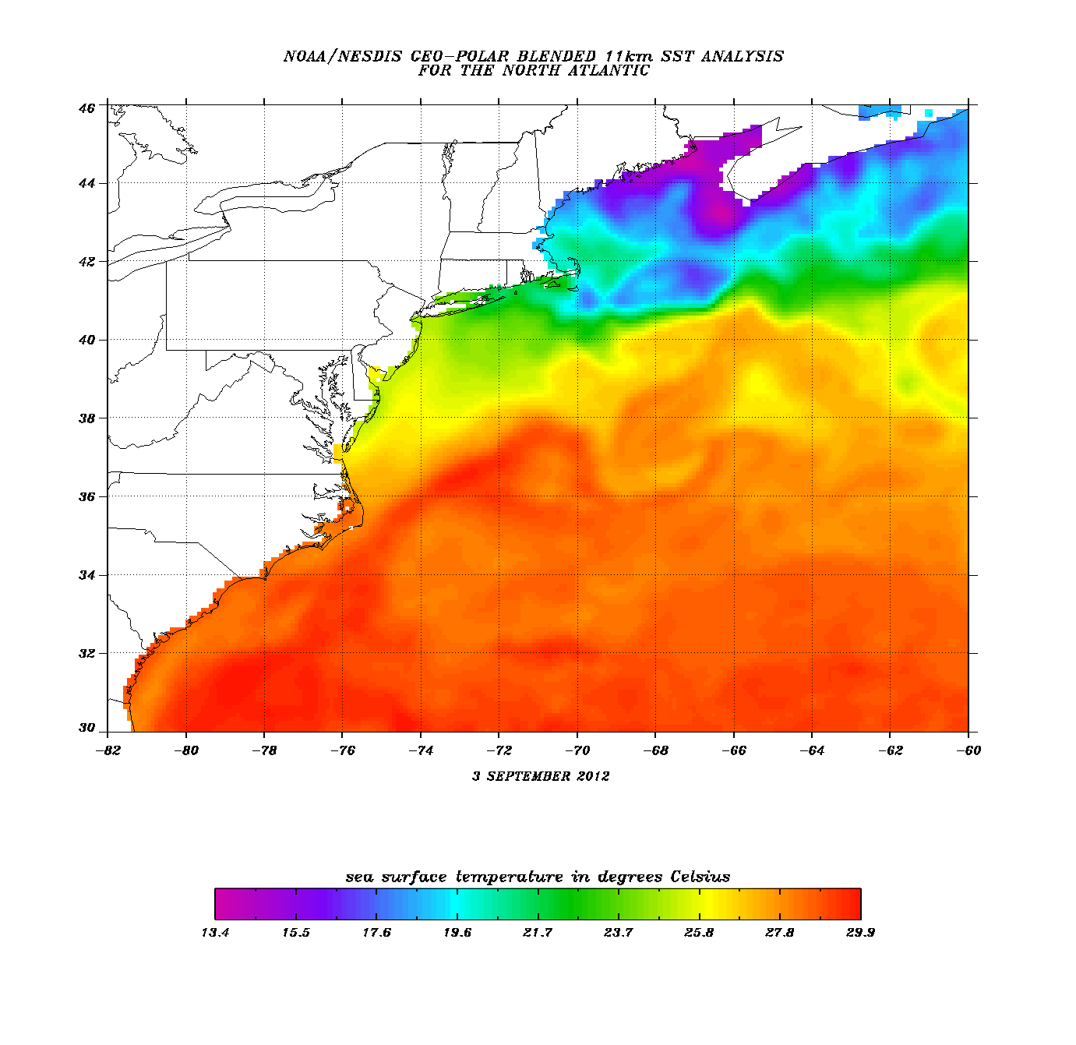

Slide 10
IV. Altitude
Air cools as it rises above the Earth’s surface
Appalachian Mountains
higher elevations = cooler air
acts as a barrier on the west

Slide 11
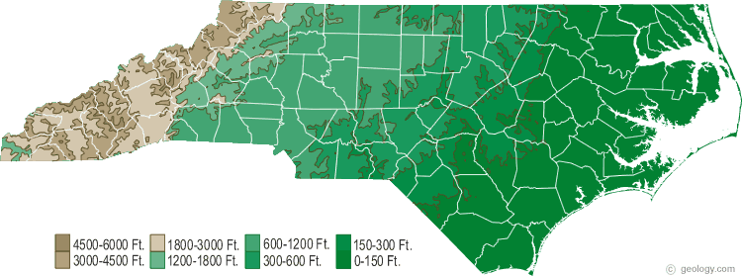

Slide 12
V. Precipitation
Water released from the atmosphere
Rain, sleet, hail, fog, snow, or dew.
Depends on regional temperatures
NC has little snow, most in mountain region

Slide 13
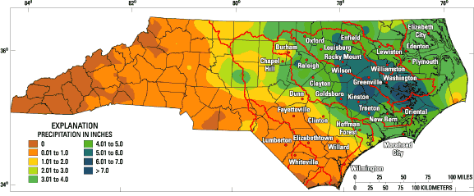

Slide 14
VI. Winds
Thunderstorms
Most common windstorm in N.C. Caused by rapidly rising warm air and cold downdrafts of air
Hurricanes
Need warm ocean water to develop. Winds reach between 74 and 150 mph.
Tornadoes
Wind speeds can reach 500 mph. Can strike at anytime of year anywhere in N.C. These are the most violent.

Slide 15
?

Slide 16
?

Slide 17
?

Slide 18
VII. Natural Resources
Determine how people live and work in an area
Coastal Plains – Rich soil called loam
- attracted early settlers
Piedmont – Clay, rockier, poor for farming
Mountains – rocky
-Home to a large variety of trees

Slide 19
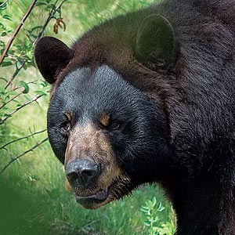
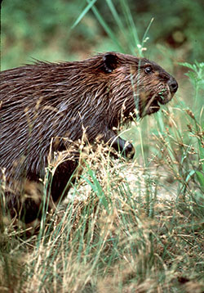
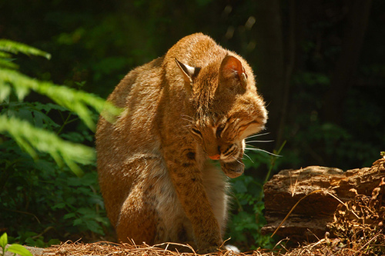
VIII. Nature & Wildlife
Warm climate = wide variety of species
Trees
-Most important economically
Wildlife
-Bears, deer, groundhog, possum, wildcats

