Slide 1
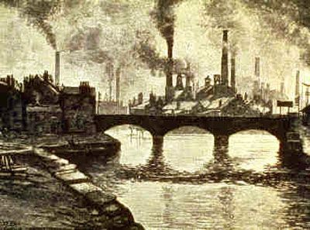
Immigration
From Where?
Why?
Living Conditions?

Slide 2
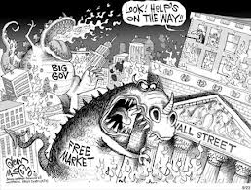
Economics
Laissez-faire Economics
G’vt does not get involved in business
Strongest businesses succeed & make more $$$$
Companies supported until it did not benefit them

Slide 3
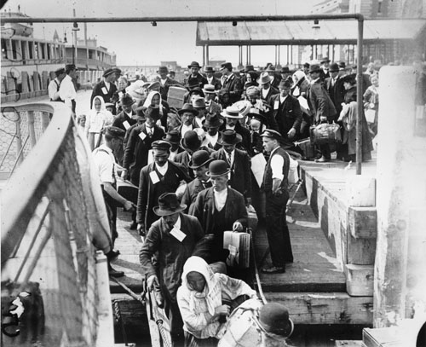
Immigration
Why?
1. JOBS!!!
2. free land == Homestead Act
3. $$$$$
4. personal freedoms >>>public schooling, democratic g’vt, freedom of speech & religion

Slide 4
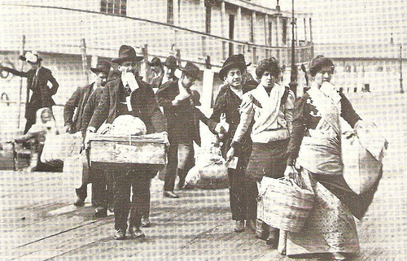
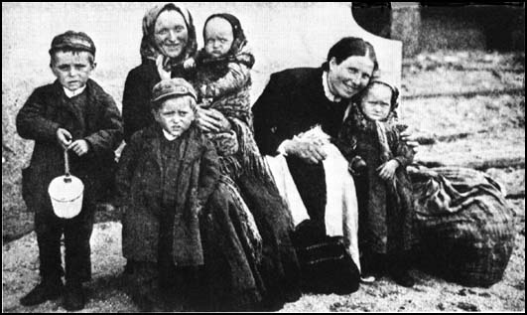
OLD Immigrants
Came to US between 1865-1890
Came from North & Western Europe
--Germany, Britain, Scandinavian, & IRISH
Estimated to be about 10 million

Slide 5
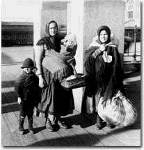
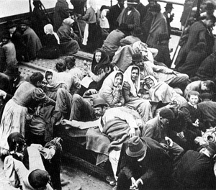
New Immigrants
Slavs coming to the US
Came to the US between 1890-1914
Came from southern & Eastern Europe
--Russians, Armenians, Slavs, Jews, Greeks, & ITALIANS
Estimated to be about 15 million people
Italians coming to the US

Slide 6
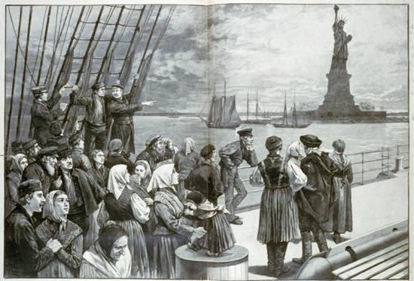
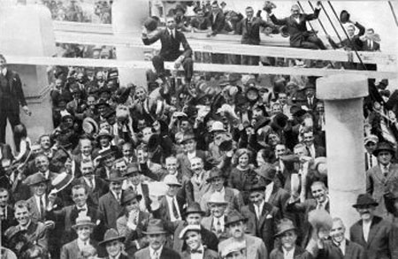
Ellis Island
Most immigrants came through
Must be checked
Some are sent back
Diseases
Certain nationalities not allowed in
http://www.youtube.com/watch?v=5rredHTyKaQ&feature=related

Slide 7
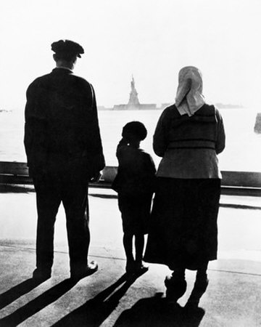
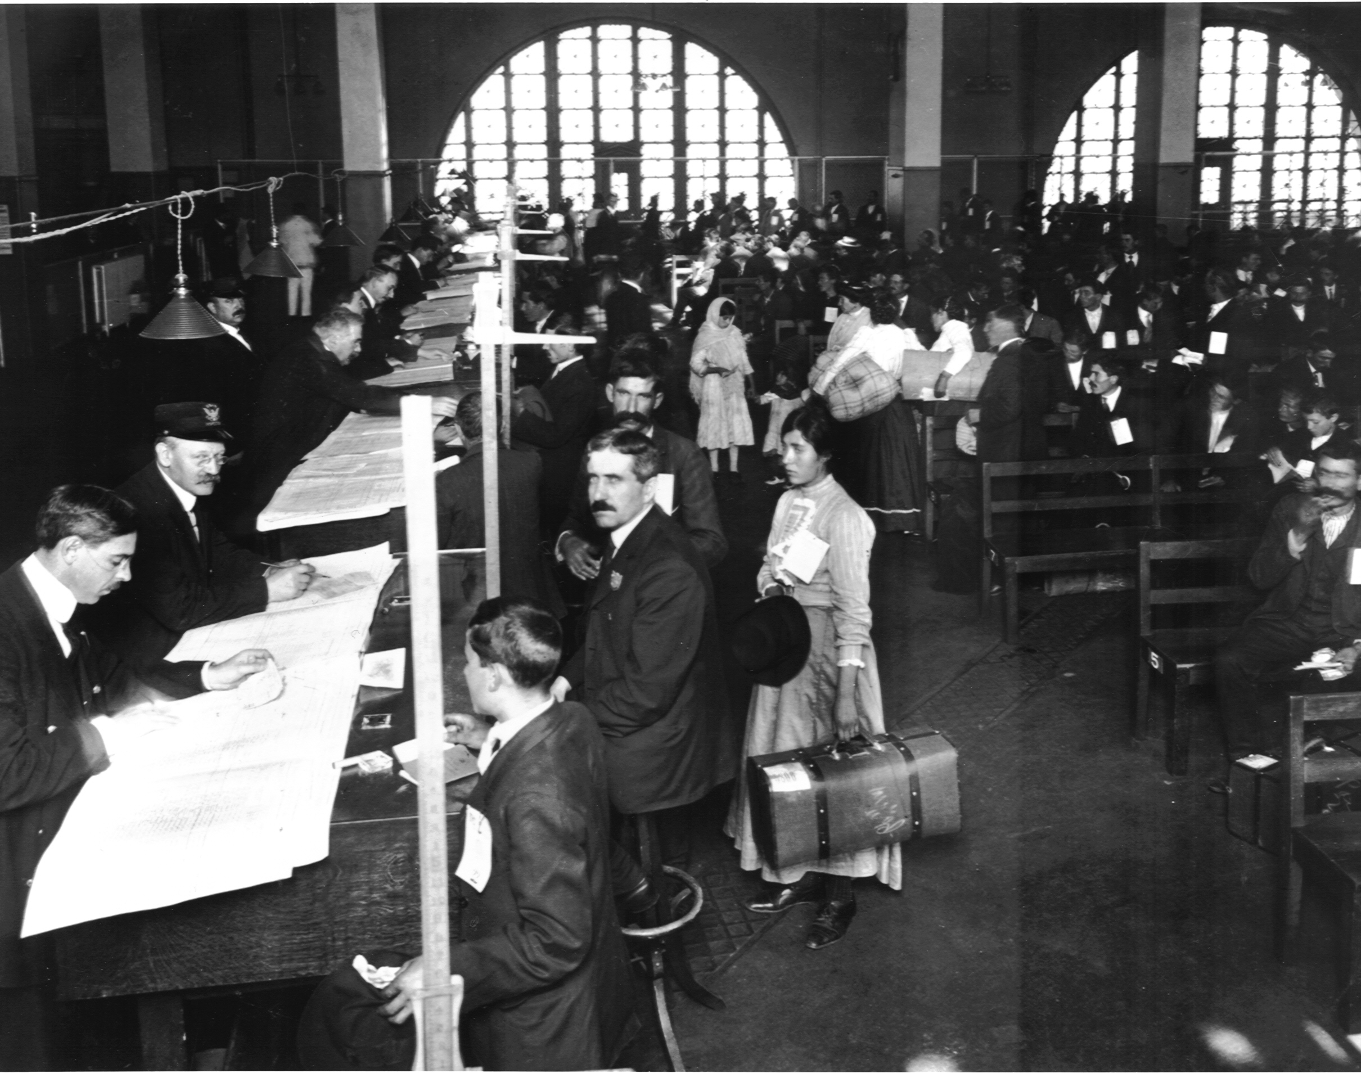
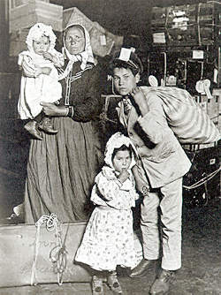
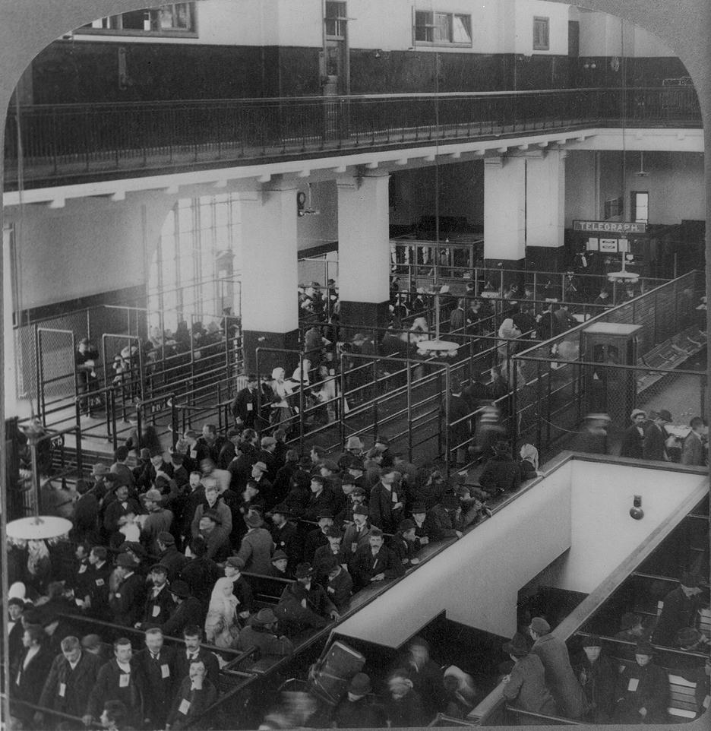
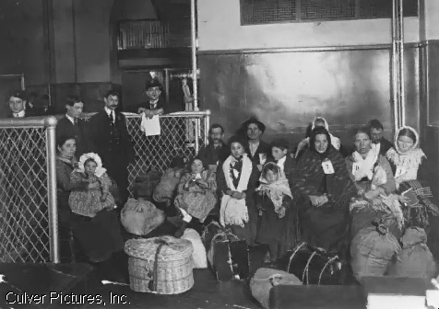
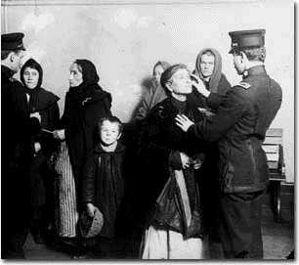
Photos of Ellis Island

Slide 8
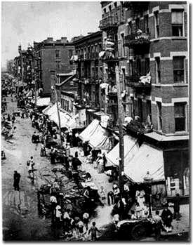
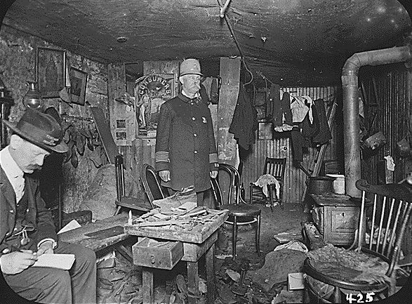
Where Do They Live?
Each group settled near people of common heritage
a. Little Italy = Italians
b. Hell’s Kitchen = Irish
Most settle in cities
a. NYC, Boston, Chicago, Rochester, Buffalo, etc…
Conditions were horrible
Lived in Tenements
http://www.youtube.com/watch?v=UxxSV1F-sM4&feature=fvsr

Slide 9
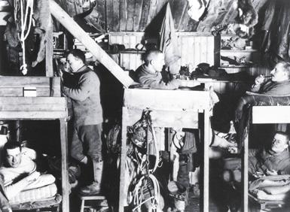
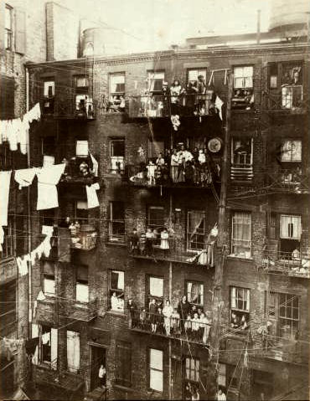
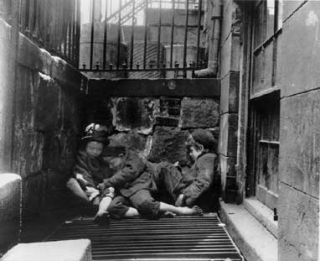
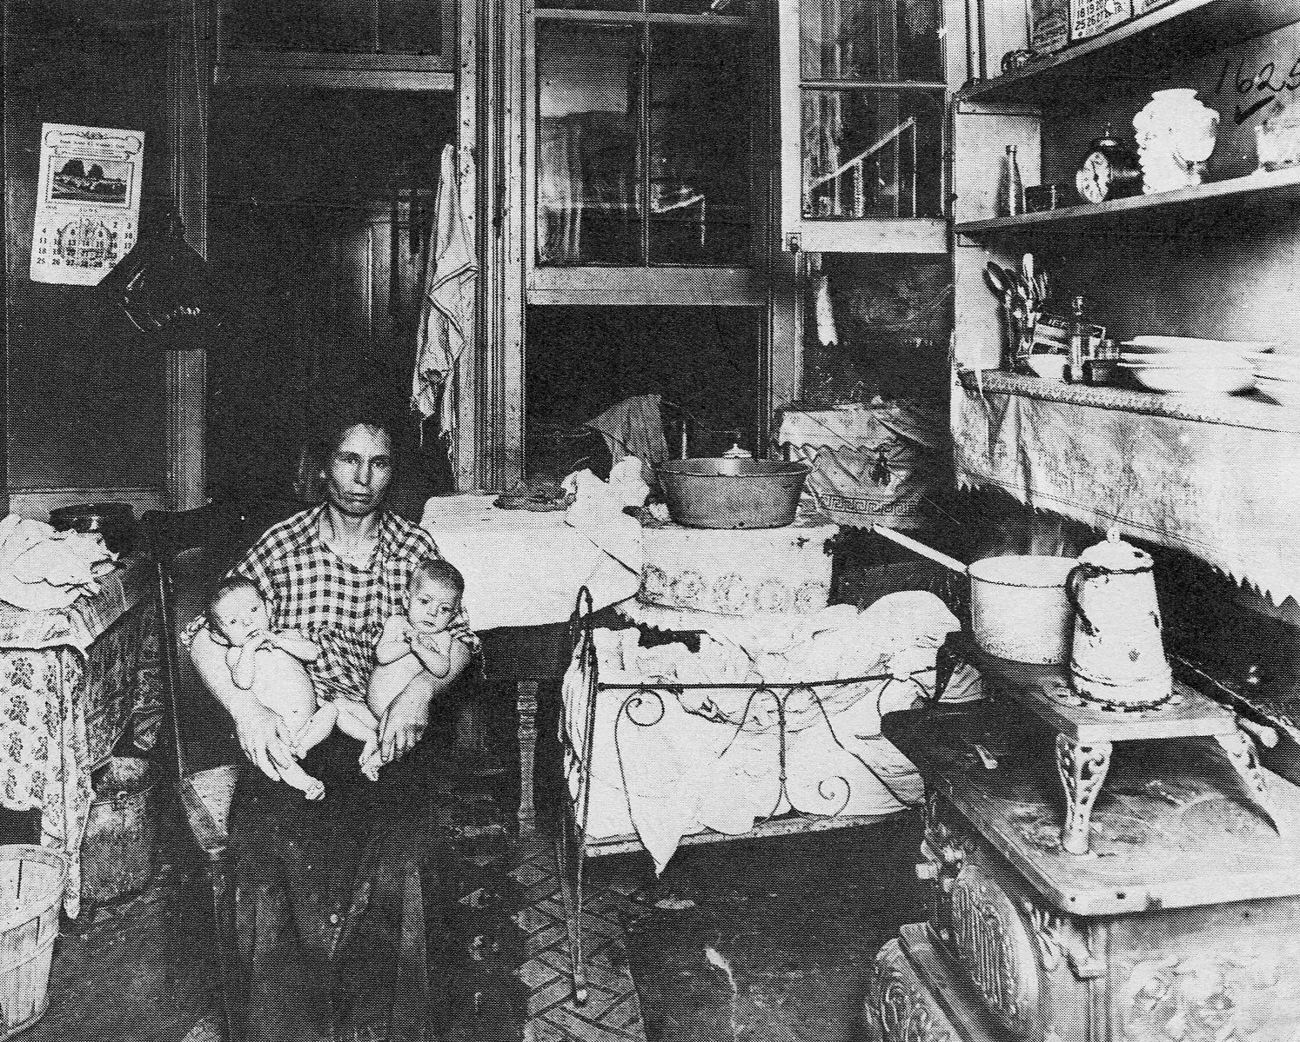
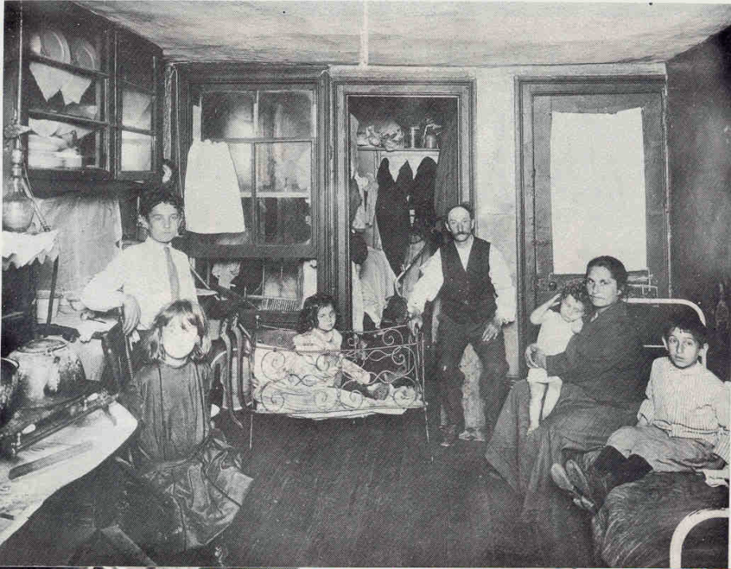
Photos of Tenements

Slide 10
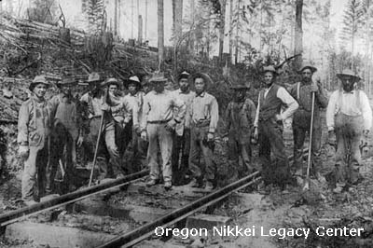
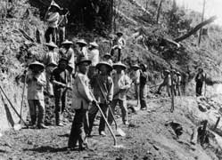
Asian Immigrants
Chinese were recruited to work on railroads
a. had to work until they paid for their voyage
Chinese were excluded from Unions
Forced to accept lower wages

Slide 11
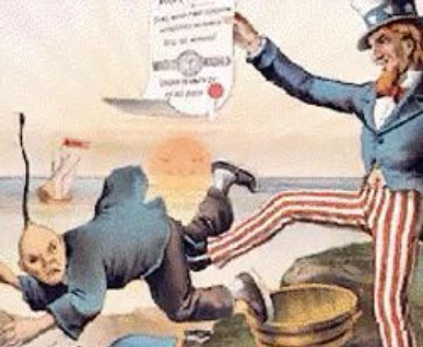
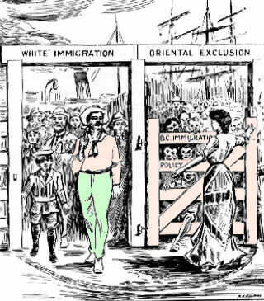
Chinese Exclusion Act
Passed in 1882 to not allow Chinese immigrants into US
Americans had very racist attitude
Believed Chinese were inferior to whites

Slide 12
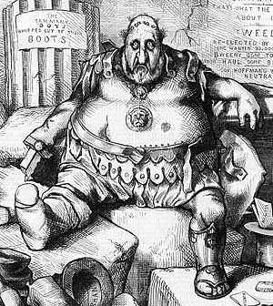
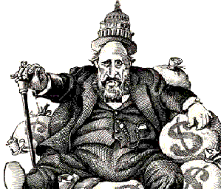
Political Machines
An unofficial organization designed to keep certain people in power
Traded favors for votes
--jobs & homes for new immigrants
C. “Boss” Tweed of NYC was the most powerful

