Slide 1
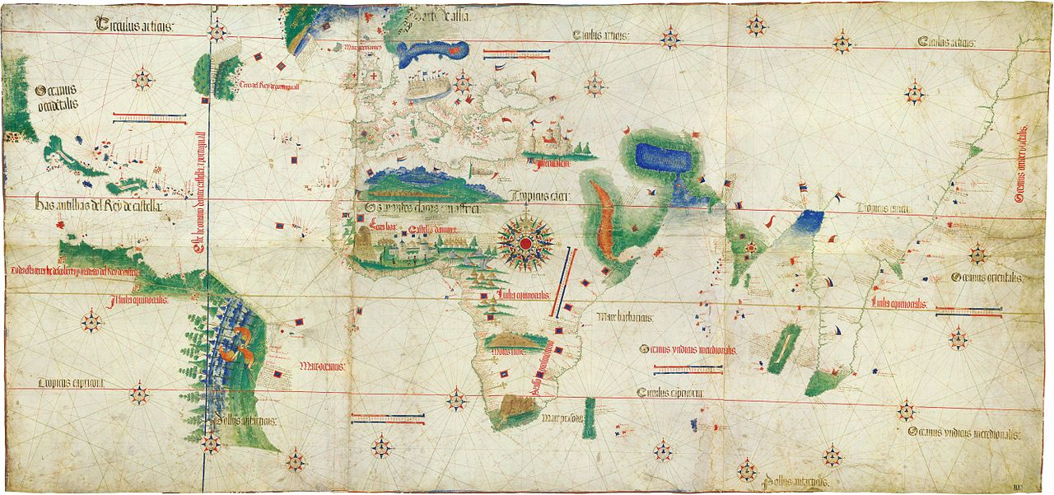
Age of Exploration-
The Explorers
A map from 1503 that shows the known lands of the time
Discovery Ed Video: The New World Encountered

Slide 2
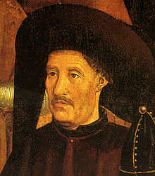
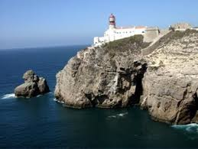
Henry the Navigator
In the early 1400s, he established a shipbuilding and navigation school in Portugal
His students learned how to build and steer ships
  The caravel was a medium-sized ship that was faster and easier to navigate than other ships of the time
Henry also taught his students how to use a compass and the position of stars to figure out their location and which direction they were going
Discovery Ed Video:
The Portuguese Explorers

Slide 3
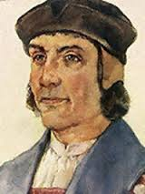
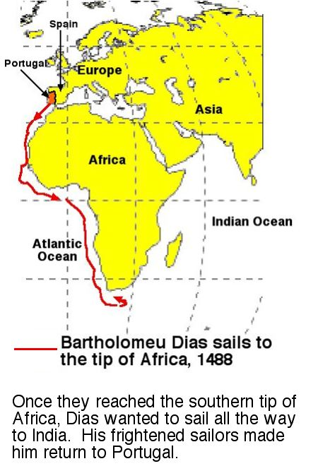
Bartolomeu Dias
From Portugal, he was student of Henry the Navigator
He became the first European to sail around the tip of Africa and reach the Indian Ocean in 1488
Europeans now realized it was possible to reach India by sea

Slide 4
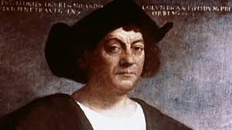
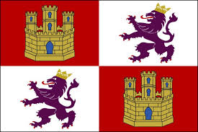
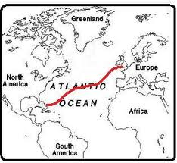
Christopher Columbus
From Italy
Convinced the Queen Isabella of Spain that he could reach India by sailing to the west
  Many people believed the world was flat and he would sail off the edge!
Landed in the Bahamas in 1492, becoming the first European to reach the Americas
Flag of Spain in 1490

Slide 5
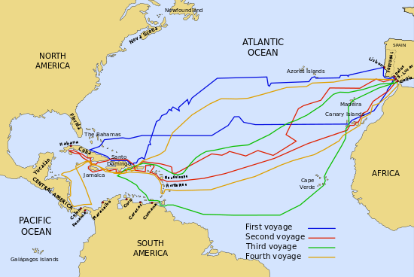
The voyages of Christopher Columbus
(1492-1503)

Slide 6
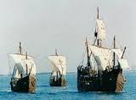
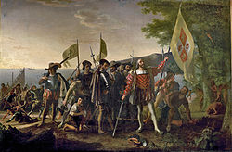
Christopher Columbus
Traveled with three ships:
  The Nina, Pinta, and Santa Maria
When Columbus landed in the Bahamas, he believed he had reached India
  He called the locals “Indians”

Slide 7
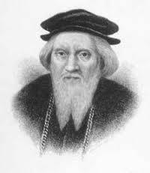
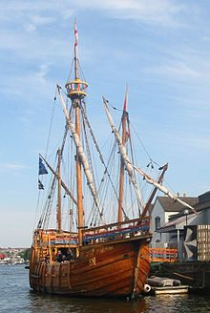
John Cabot
Italian explorer who sailed for the king of England
First European explorer to reach the mainland of North America in 1497
Took a route further north than other explorers, reached Canada

Slide 8
Cabot’s Voyage in 1497

Slide 9
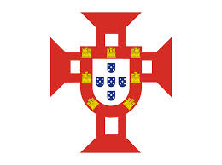
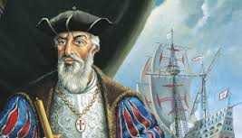
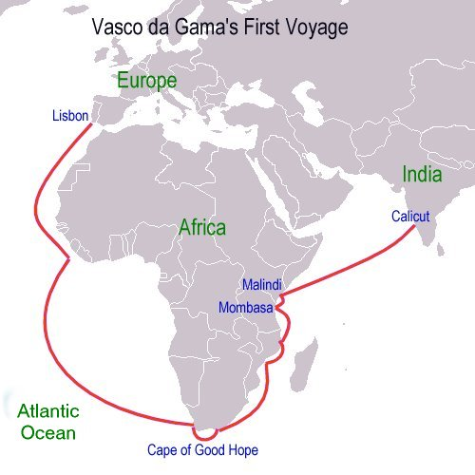
Vasco de Gama
Portuguese explorer
The first explorer to reach India by sea in 1498
Sailed around Africa
His journey helped expand trading between Europe and Asia

Slide 10
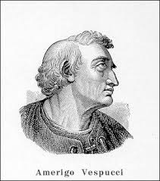
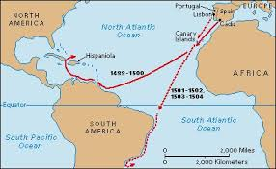
Amerigo Vespucci
Italian explorer
He led several expeditions that reached North and South America starting in 1499
Vespucci realized that he was not in India, but instead had reached a new continent
This is where the name “America” comes from

Slide 11
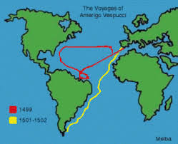
Amerigo Vespucci’s Expeditions
(1499-1502)

Slide 12
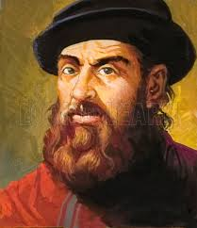
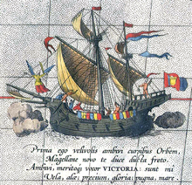
Ferdinand Magellan
A Portuguese explorer, sailed for the king of Spain
He is known for leading the first expedition to circumnavigate the globe
  Circumnavigate means he went all the way around the world
He was killed in 1521 in the Battle of Mactan against a local tribe in the Philippines
  His crew returned back to Spain in 1522

Slide 13
Magellan’s Voyage
(the first voyage to circle the globe)

Slide 14
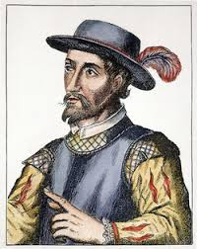
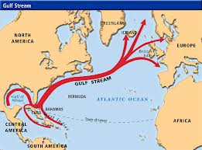
Juan Ponce de Leon
Spanish explorer
He was part of Christopher Columbus’ crew
He became the first governor of Puerto Rico in 1509
In 1513, he reached the coast of Florida and became the first European explorer to reach the mainland of present-day U.S.
  He also discovered the Gulf Stream current

Slide 15
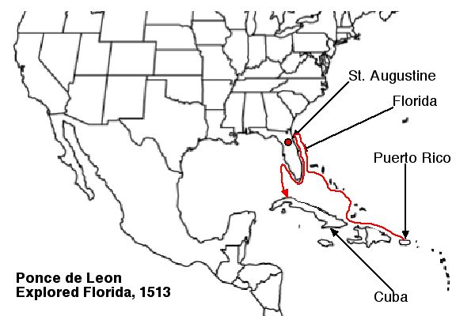
Expedition of Ponce de Leon to Florida in 1513

Slide 16
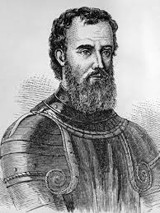
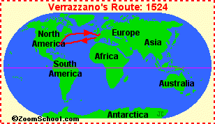
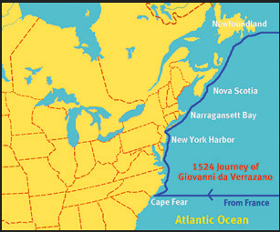
Giovanni de Verrazano
Explorer from Florence, Italy
In 1524, he led an expedition along the east coast of present-day United States
He was the first European to explore the outer banks of North Carolina and New York Bay

Slide 17
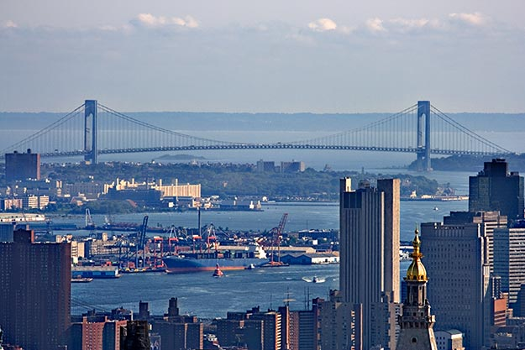
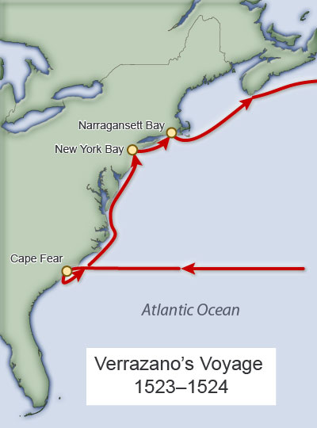
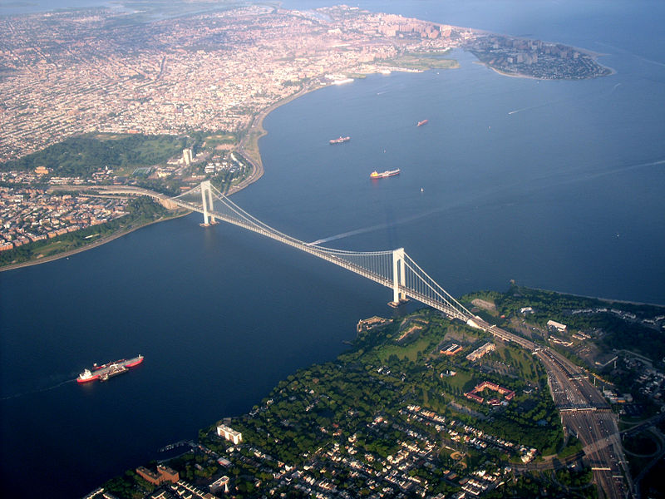
Giovanni de Verrazano Expedition in 1524
Today, the Verrazano-Narrows Bridge connects Staten Island and Brooklyn in New York City

Slide 18
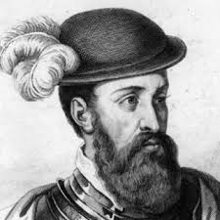
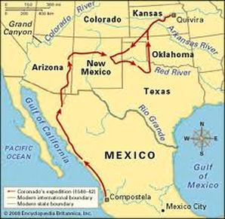
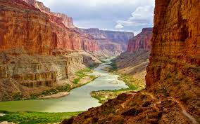
Francisco Coronado
Spanish explorer
In 1535, he arrived in New Spain (Mexico)
In 1540, he led an expedition to explore the lands to north of New Spain
  Present-day Arizona, New Mexico, Texas, Oklahoma and Kansas
He was the first European to see the Colorado River and the Grand Canyon

Slide 19
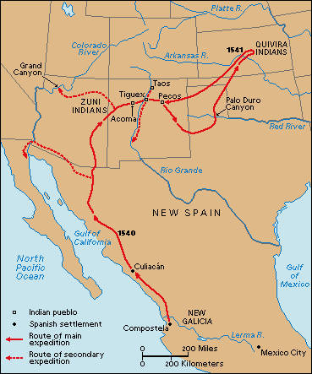
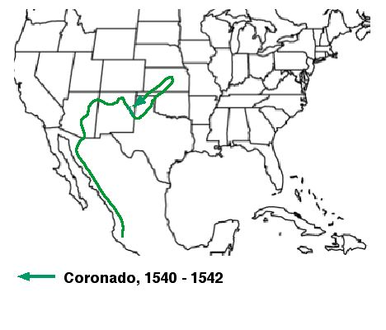
Francisco Coronado’s Expedition
(1540-1542)

