Slide 1
Exploration & Colonization
1492-1673

Slide 2
Essential Question
Why did Europeans explore the world’s oceans and colonize the Americas?

Slide 3
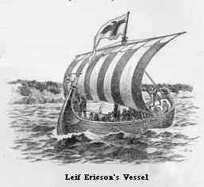
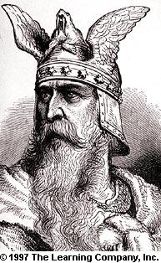
Before the Era of Exploration
In 1000, Viking sailors led by Leif Ericson Sailed off course returning home to Greenland and instead reached North America (which became known as Vinland). They left no permanent settlement due to the Native American Clashes.

Slide 4
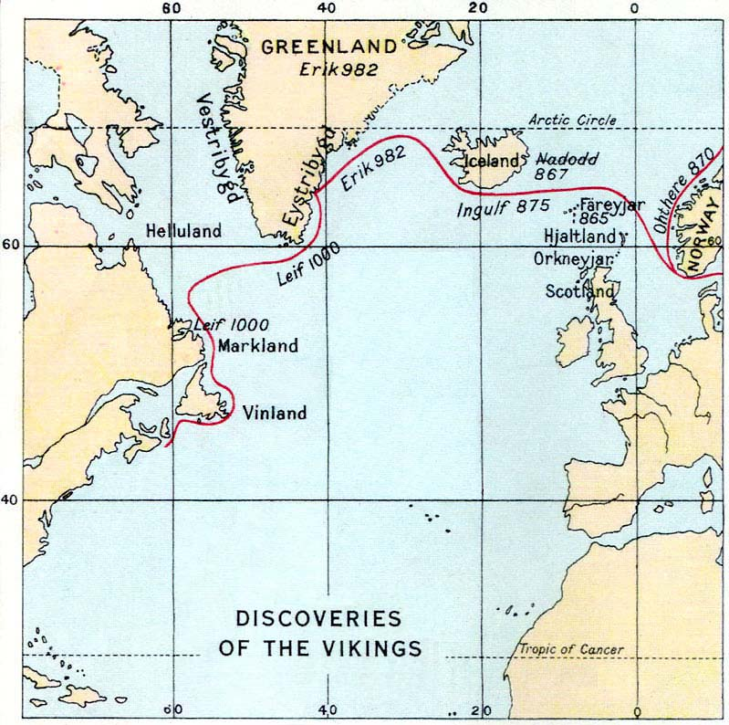

Slide 5
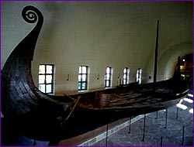
Discovered in Norway in 1906, the Oseberg ship, the best preserved Viking ship ever found, reveals its Norse shipbuilders' graceful construction style.

Slide 6
Fast Forward to the 15th Century!!
In the Middle Ages Marco Polo (1254 -1324) returned from China and wrote about the marvelous things he had witnessed there: Spices from the East Indies, Chinese Tea, and Asian Cottons and Silks.
By the 15th century, Europeans were aware of places as distant as Africa, India and China. However, they had no idea of the existence of the Americas.
European rulers were anxious to find an all sea route to Asia (India, China, Spice Islands), but why????

Slide 7
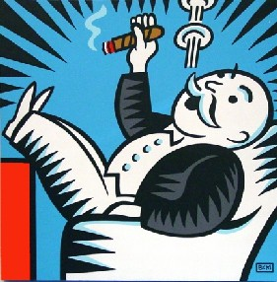
THE SILK ROAD
What is a monopoly, and are they good for consumers? Why, or why not?

Slide 8
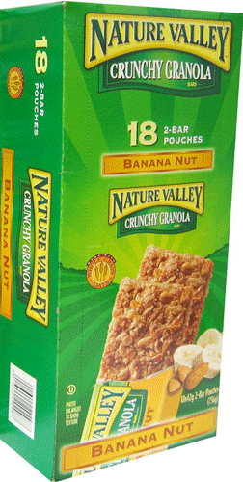
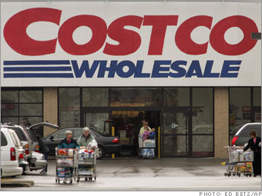
Economic Principle of the “Middle Man”
I’m hungry!
Deli (Retail)
Costco (Wholesale)
Therefore, what does it mean, economics, to “skip the middle man”?
$13.74 for a box of 18 at Costco
Granola Bar $1.00 at the deli
You can save money by buying wholesale prices, instead of retail.
How much would it cost you to buy 18 granola bars at the deli?
How much money would you save if you bought a box of granola bars from Costco?
$18.00
$4.26

Slide 9
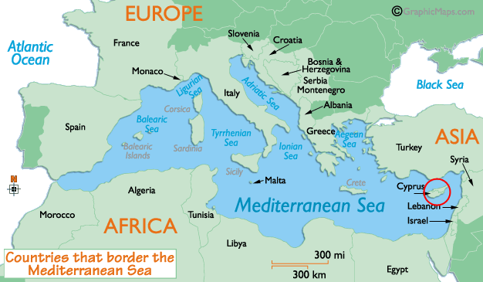
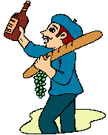
Estoy cansado de pagar a los italianos tan altos precios por los productos de Asia!
Moi aussi!

Slide 10
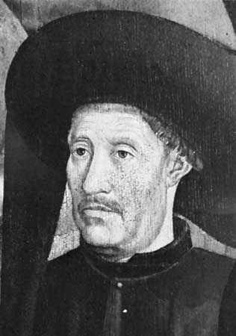
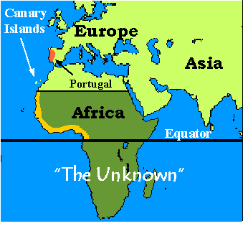
Early Portuguese Exploration
In 1419, Prince Henry the Navigator started a school in Portugal for sailors, captains, navigators, and mapmakers.
Prince Henry the Navigator
Map of African coast discovered by expeditions sponsored by Prince Henry

Slide 11
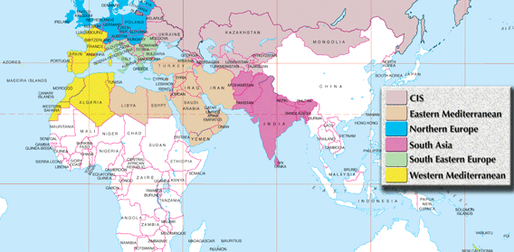
Europeans were tired of paying the Italians high prices for Asian products. What did they do about it?
Europeans began “skipping the middle man”, sailing directly to Asia to buy their products at a lower price.

Slide 12
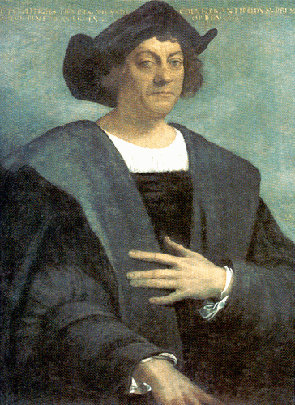
Christopher Columbus
1492 – Made the Atlantic crossing with the Niña, Pinta, and Santa Maria.
He traveled for Spain, hoping to reach the East Indies by sailing across the Atlantic.
Instead, he reached the West Indies, islands in the Caribbean.

Slide 13
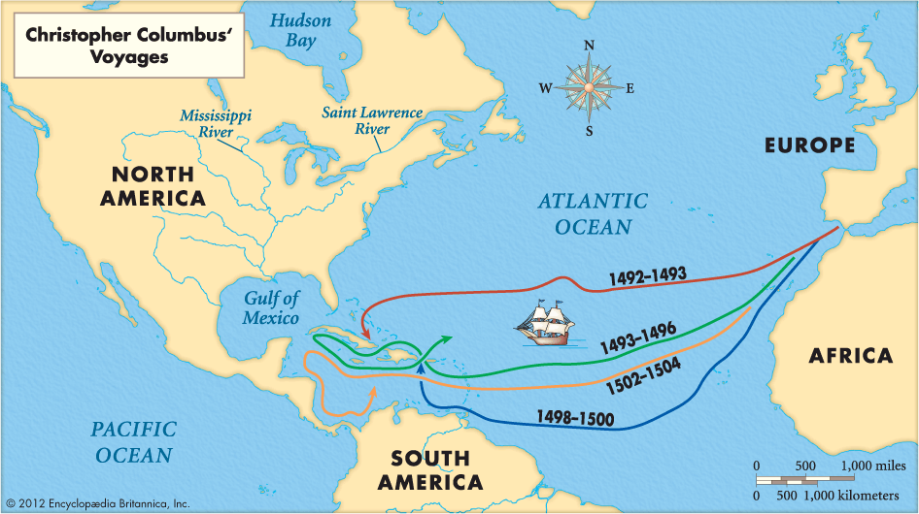

Slide 14
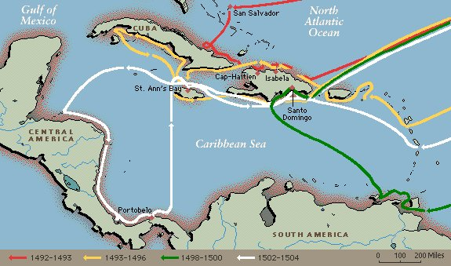

Slide 15
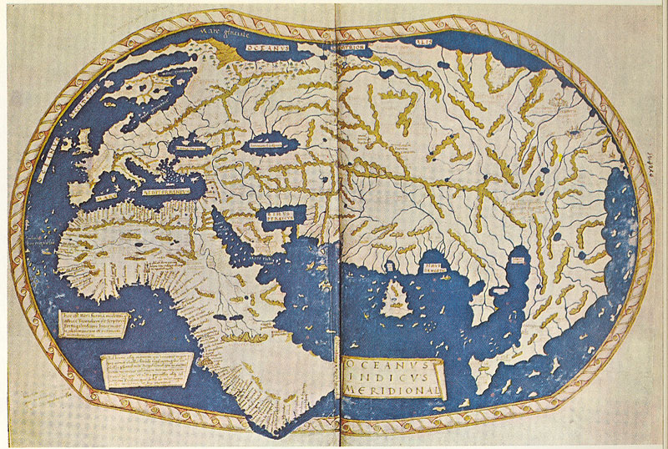
What was Columbus hoping to find by sailing West across the Atlantic Ocean from Spain?
China

Slide 16
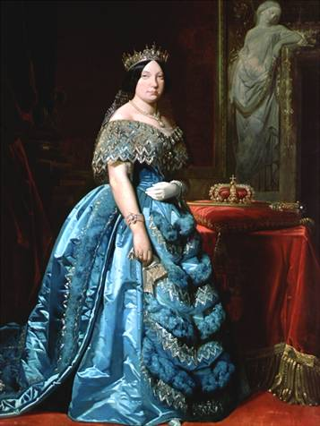
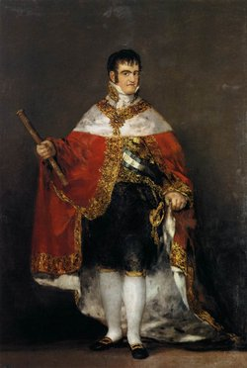
Why did Columbus leave Portugal for Spain in 1485?
King of Portugal refused to grant him permission to sail.
Which Spanish queen was in favor of supporting Columbus’ voyage?
Queen Isabella
(left) Queen Isabella and (right) King Ferdinand

Slide 17
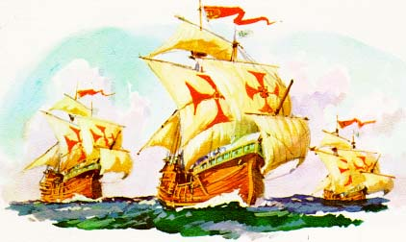
How many ships and men were promised to Columbus for his voyage?
3 ships and 90 men
What were the names of the ships on Columbus’ first voyage?
Nina, Pinta, and Santa Maria

Slide 18
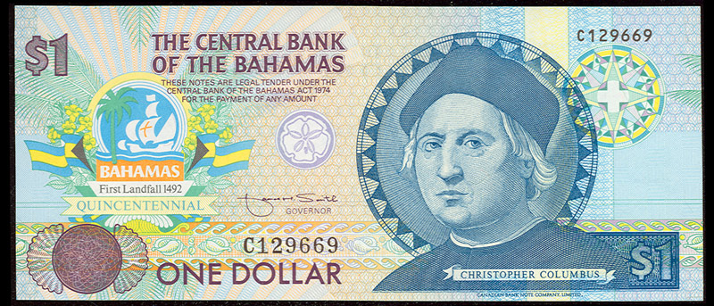
On Columbus’ first voyage, why didn’t the scared and desperate sailors mutiny, kill Columbus, and return to Spain?
Only Columbus knew how to get back to Spain.
What is the name of the modern country where Columbus first landed?
the Bahamas

Slide 19
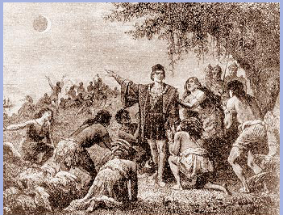
How did Columbus trick the Indians of Jamaica into feeding his crew?
Knowing an eclipse would soon occur, he threatened to take away the moon. After the eclipse occurred, the Native Americans were fearful of Columbus and fed his crew.

Slide 20
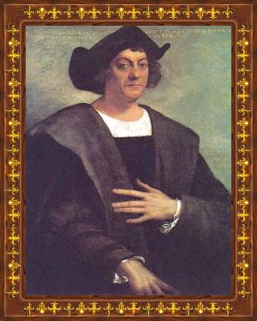
“Discovery consists of seeing what everybody has seen and thinking what nobody has thought.”
Christopher Columbus, The Admiral who changed the world

Slide 21
Lasting Impact of Columbus
His voyages marked the beginning of lasting contact between Europe, Africa, and Americas.
Devastated the Native American population.
Columbian Exchange: exchange of goods, ideas, disease, etc. between the Eastern and Western Hemispheres.

Slide 23
 | Old World to New World | New World to Old World
Diseases | Smallpox, Measles, Chicken Pox Malaria, Yellow Fever, Influenza, The Common Cold | Syphilis
Animals | Horses, Cattle, Pigs, Sheep Goats, Chickens | Turkeys, Llamas, Alpacas, Guinea Pigs
Plants | Rice Wheat Barley Oats Coffee Sugarcane Bananas Melons Olives Dandelions Daisies Clover Ragweed Kentucky Bluegrass | Corn (Maize) Potatoes (White & Sweet Varieties) Beans (Snap, Kidney, & Lima Varieties) Tobacco Peanuts Squash Peppers Tomatoes Pumpkins Pineapples Cacao (Source of Chocolate) Chicle (Source of Chewing Gum) Papayas Guavas Avocados

Slide 24
Switch to Colombian exchange power point

Slide 25
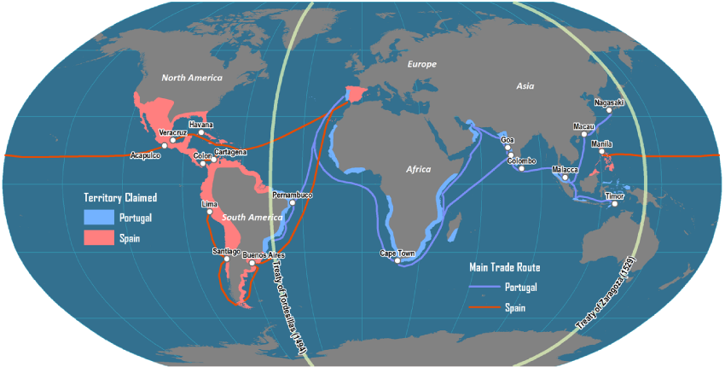
Treaty of Tordesillas
After the discovery by Columbus, both Spain and Portugal wanted the Pope to decide who would control the lands that European sailors were exploring.
In 1493, the Pope drew an imaginary line around the world; however, Portugal was upset and demanded the line be moved 800 miles further west resulting in the Treaty.

Slide 26
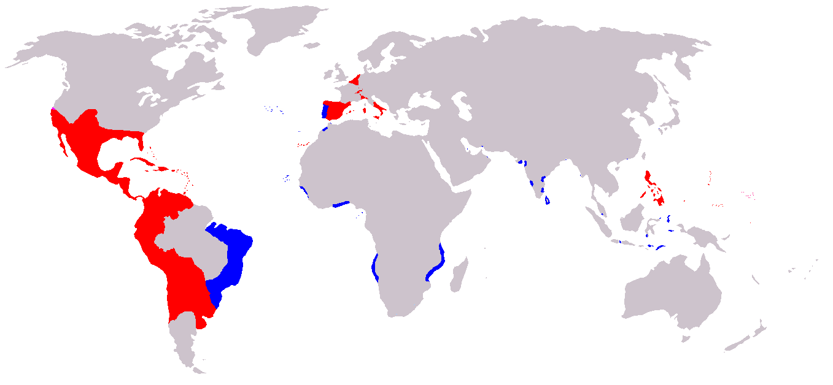
Treaty of Tordesillas
Spanish and Portuguese Empires in the 16th Century

Slide 27
Spain Builds an Empire
Balboa – crossed the isthmus of Panama and claimed the Pacific for Spain
Magellan – circumnavigated the globe.
Cortés – Conquered the Aztecs, killed their emperor Montezuma.
Pizarro – Conquered the Incas
De Soto – explored Florida and died looking for gold he never found
Coronado – claimed present day New Mexico and Arizona for Spain
Diaries, stories, maps
library.thinkquest.org/ J002678F/balboa.htm

Slide 28
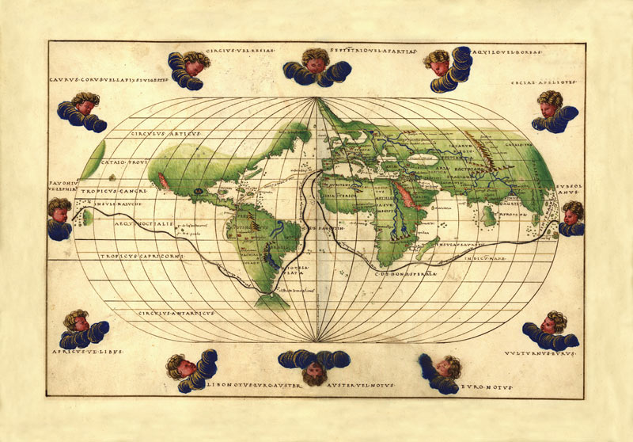
MAGELLAN’S VOYAGE

Slide 29
Colonizing North America
Search for the Northwest Passage

Slide 30
Common Reasons for European Exploration
Spain, France, Holland, and England were seeking:
An all water route to Asia by sailing west,
the Northwest Passage to India and China.
These countries wanted their merchants to control the riches of the East (the spice, silk, and gold trade).
They wanted to make their homelands (the mother country) rich and powerful.
They wanted empires-- economic empires and monopolies; political empires over vast territories.
Notes:
What were the European countries hoping to find by sailing west?
Describe again the meaning of the following: empire; monopoly; mercantilism

Slide 31
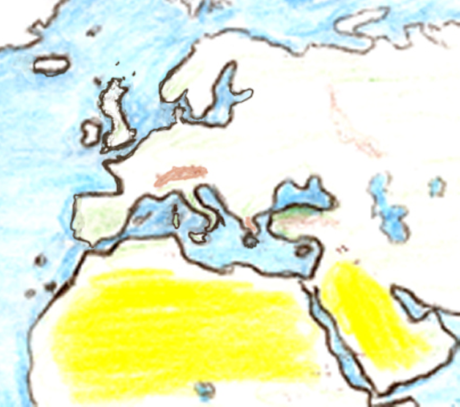
England
(Great Britain)
Netherlands (Holland; the Dutch)
Spain Portugal
France

Slide 32
Northwest Passage
Many explorers searched for the infamous Northwest Passage, but one was never found.
However, these European countries found many other great things that kept them coming back to the “New World”.

Slide 33
Northwest Passage

Slide 34
Common Reasons for European Exploration
Spain – Spanish explorers came to the New World looking for the 3 G’s (God, Gold, & Glory).
France – French explorers and settlers discovered something much better than gold, Beaver Fur!
Netherlands – Settled New York, also valued beaver fur.
England – English settlers came to the new world for a variety of reasons including, religious freedom, land, trade, to start a new life, or to escape debtors prison.

Slide 35
New France (Canada)
Hunters and trappers (coureurs de bois – “runners of the woods”)
Established friendly relations with the Indians
Expanded down the Mississippi River
largely free of government control

Slide 36
New France

Slide 37
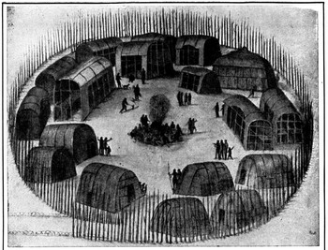
England
Settled along the Atlantic Coast
Leads to the creation of the 13 Colonies
Roanoke Colony, NC - 1585
1st Colony in the New World from England
Over 100 men, women, and children were left to establish a Colony
When ships returned with supplies in 1590, the colony was deserted, and all houses and fortifications were dismantled

Slide 38
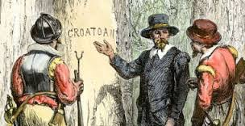
England
Roanoke Colony (cont)
All that was found were two carvings in the trees – “Croatoan” and “Cro”
Sailors took this to mean the colonists had moved to Croatoan Island (now known as Hatteras Island), but they were never able to conduct a search
The colony later was referred to as the “Lost Colony”
Most people believe the colonists were taken in by the Croatoan Indians

Slide 39
Chart the Motives and Reasons for Exploration according to the PEGS
Country | Political | Economic | Geographic | Social
Spain
Netherlands
France
England
Notes:
Design your chart such as the one above.

Slide 40
