Slide 2
COLUMBIAN EXCHANGE NC SCOS 1.0
Exchange of ideas and products between the Old and New Worlds.
What would some of these ideas or products include?
2. Why would it be named after Christopher Columbus?

Slide 3
Where are the New and Old Worlds?
THE NEW WORLD
THE OLD WORLD

Slide 5
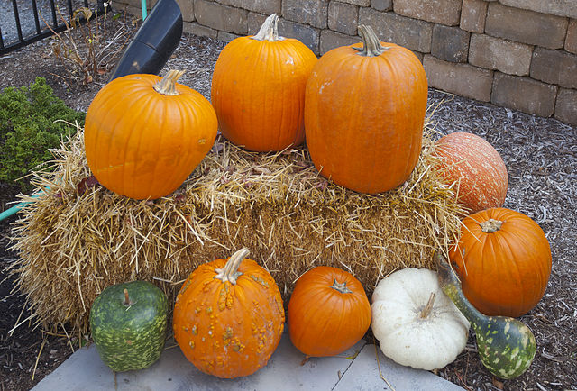
New World

Slide 6
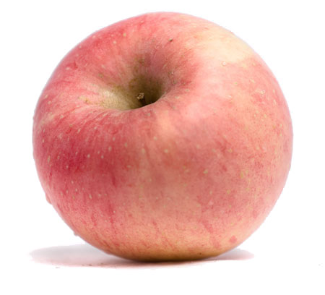
Old World

Slide 7
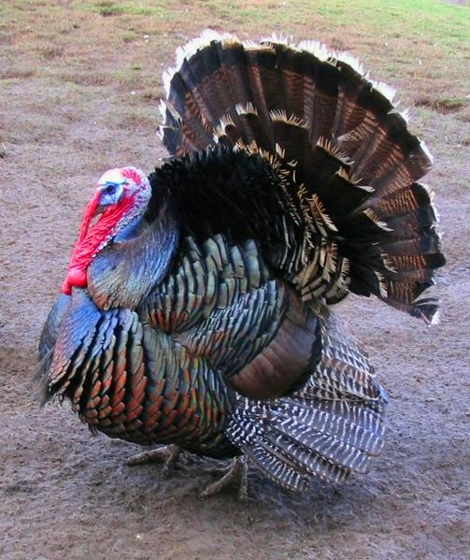
New World

Slide 8
Old World

Slide 9
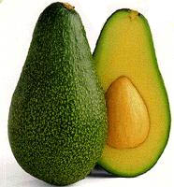
New World

Slide 10
New World

Slide 11
Old World

Slide 12
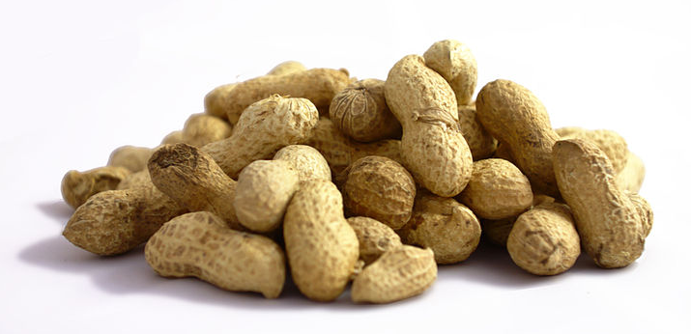
New World

Slide 13
Old World

Slide 14
Old World

Slide 15
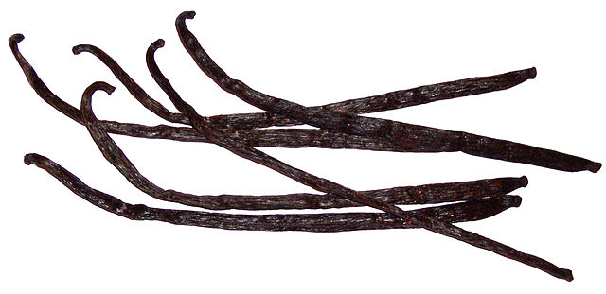
New World

Slide 16
New World

Slide 17
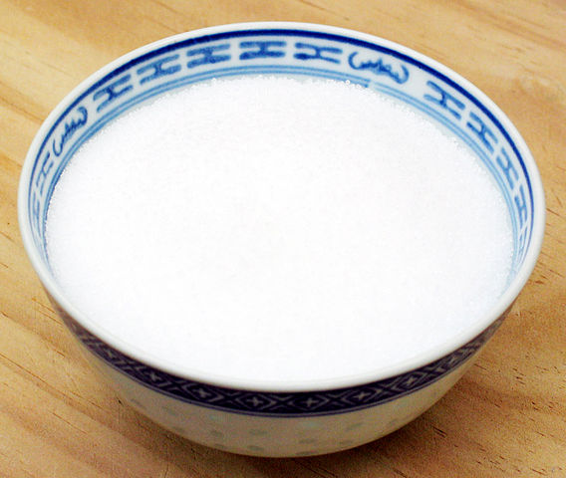
Old World

Slide 18
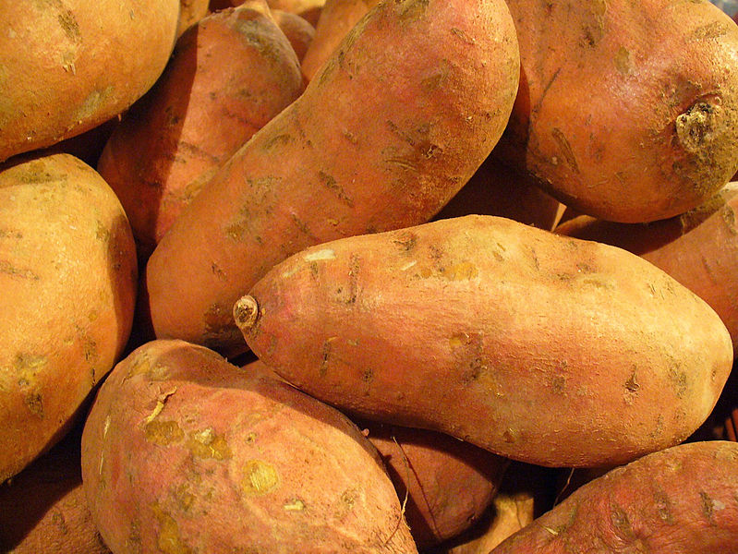
New World

Slide 19
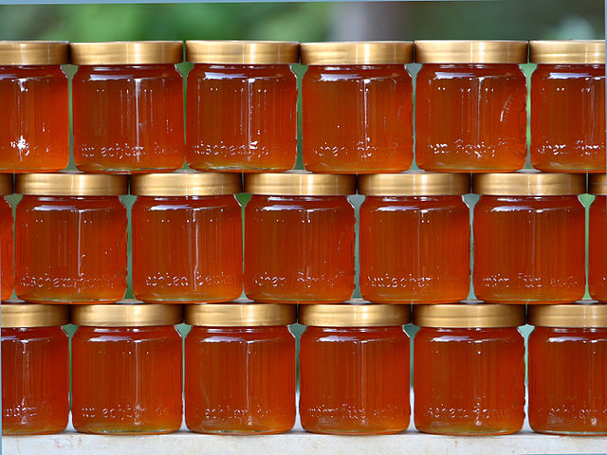
Old World

Slide 20
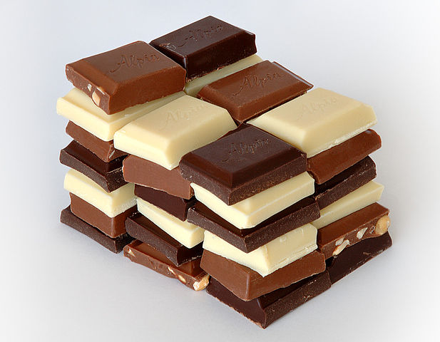
New World

Slide 21
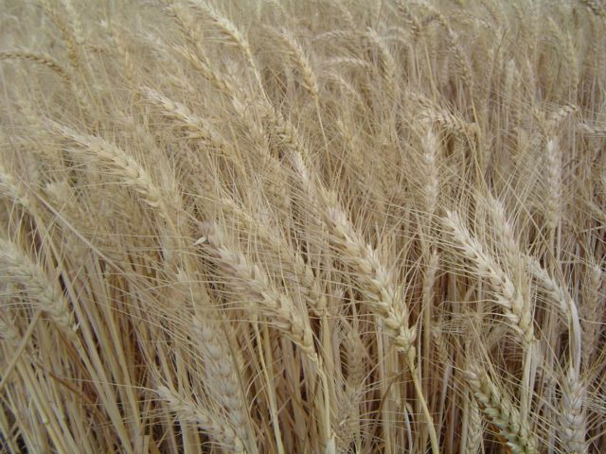
Old World

Slide 22
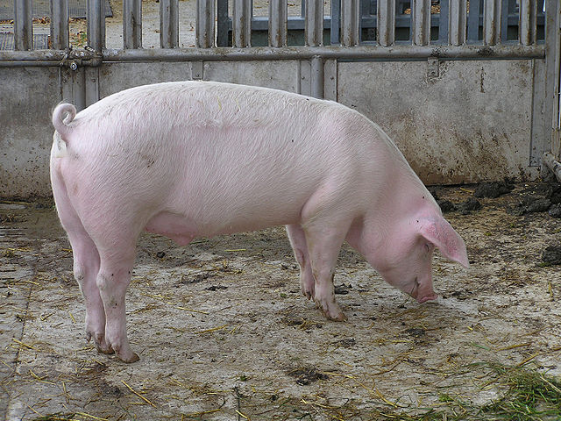
Old World

Slide 23
New World

Slide 24
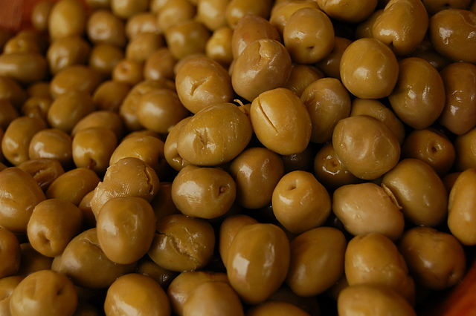
Old World

Slide 25
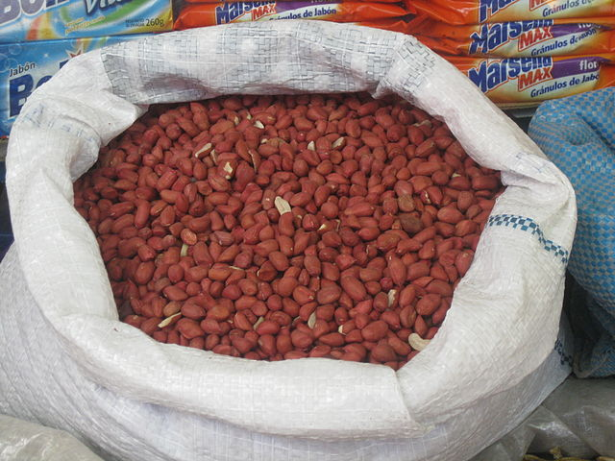
New World

Slide 26
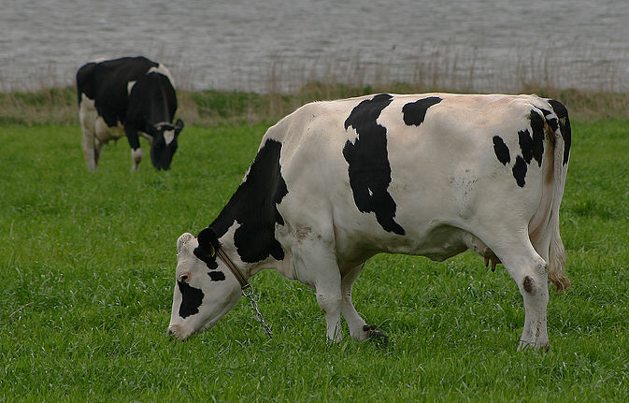
Old World

Slide 27
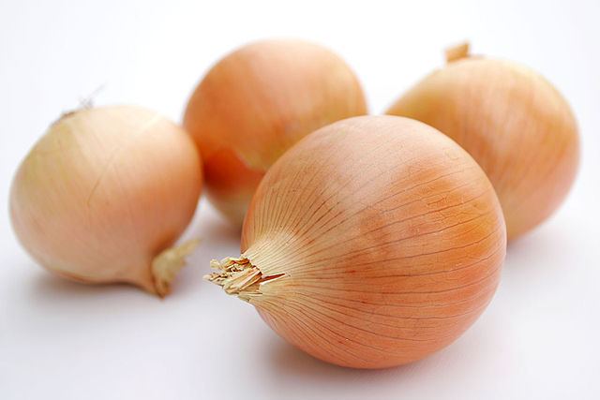
Old World

Slide 28
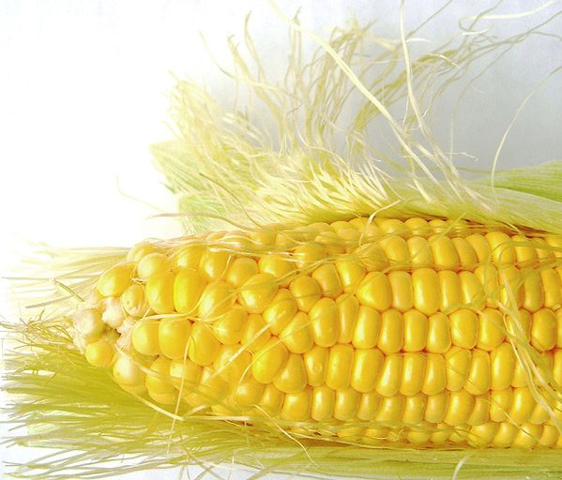
New World

Slide 29
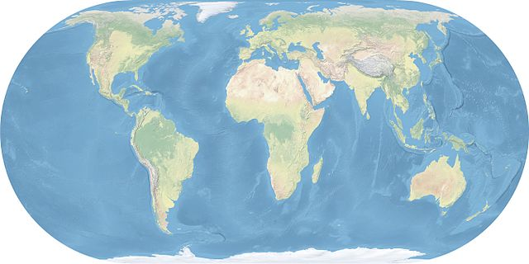
New World
Pumpkin, turkey, avocado, pineapple, peanuts, corn, tomato, vanilla, sweet potato, chocolate, chili peppers, beans, tobacco
Old World
Apples, bananas, coffee, oranges, grapes, olives, sugar, honey, cows, pigs, wheat, onions, olives, rice, smallpox, malaria

Slide 31
The Columbian Exchange led to:
C.R.O.P.S. in America
C= Cash crops grown in America.
R= Racial Slavery (Natives and Africans)
O= Oh cash crops: cotton, tobacco, coffee.
P= plantations to grow cash crops.
S= slavery in America

Slide 32
Long Term Causes: (the need for these)
God
Gold
Glory
Immediate Causes:
Europeans arrive in the Americas
Europeans bring new plants, animals and diseases to the Americas
Columbian
Exchange
Immediate Effects:
Spanish conquer Native Americans
Native Americans die of European diseases
Foods spread around the world
Long Term Effects:
Spread of products around the world
Population growth in Europe, Asia, and Africa
Migration from Europe to the Americas

Slide 38
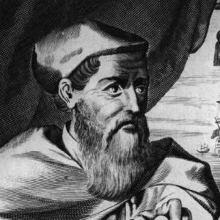
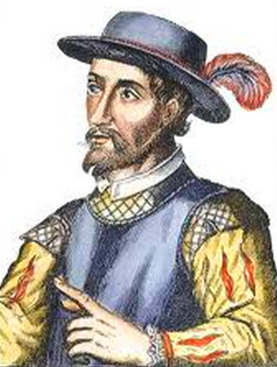
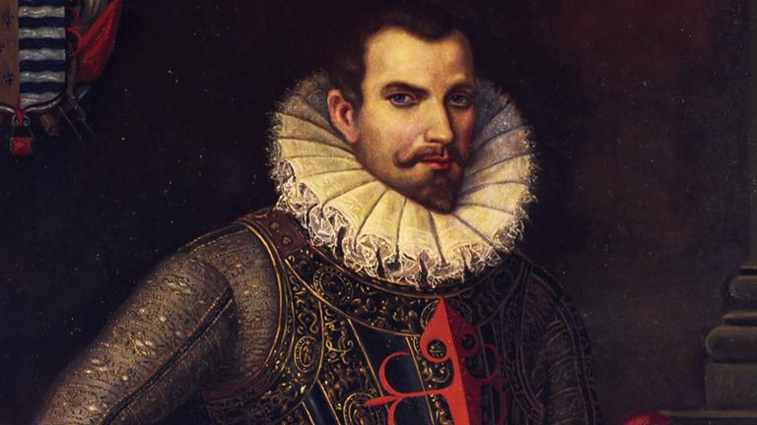
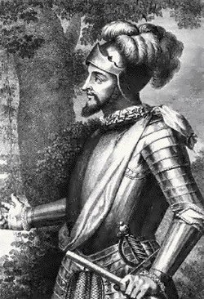
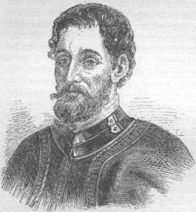
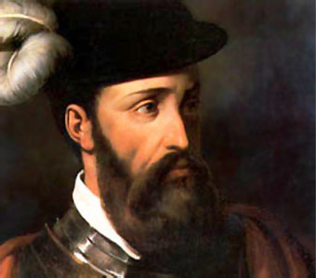
Explorer Project

Slide 39
List of Explorers
Hernando Cortes
Francisco Pizarro
Juan Ponce de Leon
Hernando de Soto
Amerigo Vespucci
Vasco Nunez de Balboa

Slide 40
Research
In your groups, you will research your explorer to create a blabberized project.
You will give a FIRST-PERSON interview as if you were the explorer himself
“I was born in….”
“When I landed in the New World…”
“Before I became an explorer…”

Slide 41
10 Questions
When were you born?
When did you die?
What country are you from?
What are the names of your parents/family?
What types of jobs have you had?
Where did you explore?
How did you get there?
What did you discover?
How was your experience?
What are some of your experiences?

Slide 42
Written Script
Once you have finished researching, you will need to write out a full script of what you are going to say
Everyone in the group must have a speaking part in the final project
Make sure it answers all 10 questions
Practice, Practice, Practice!!!!

Slide 43
Blabberize
Make an account on blabberize.com
Find a picture of your explorer
Create a mouth on the explorer
Record your dialogue
Create a new scene for every person in your group
E-Mail Ms. Newhall the link

Slide 44
Thursday, September 25, 2014
FOCUS QUESTION
Go to the following website and fill out the student needs assessment survey
Go to kms.kcs.k12.nc.us
Click on students services
Click on guidance councelors
Click on “For Students, click here” and fill out the survey. When you are done, allow someone else without a computer to do the survey!

Slide 45
Script
After you finish your research of the 10 questions and any other information about our explorer:
Talk about and compare your notes with the others in your group
Write a 2 page script that covers all the needed information (Only need 1 script per group)
Remember to put it in the FIRST-PERSON
“I was born in….”
“When I sailed across the Atlantic…”
“There was a time when I….”
Once you are done writing your script, decide who gets to say what part and PRACTICE!!!

Slide 46
Friday, September 26, 2014
NO FOCUS QUESTION
Log-in to your computers
Make sure you have your notes and script ready
One person in your group needs to pull up blabberize.com
DO NOT go any further until Ms. Newhall has given you further directions!!!

