Slide 1
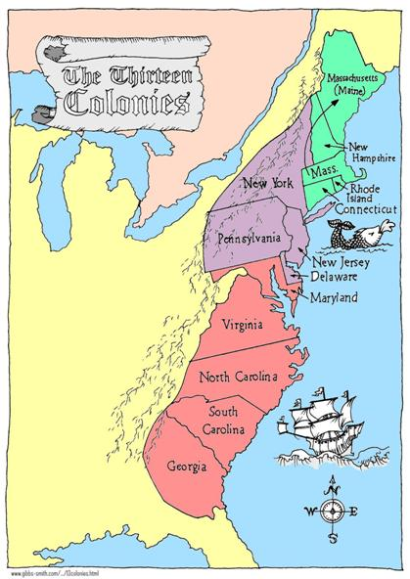
13 Colonies InTRO
3 Regions: New England Middle Colonies Southern Colonies

Slide 2
Were they all the same?
The 13 colonies were divided into 3 separate regions, the New England Colonies, the Middle Colonies, and the Southern Colonies.
The colonies were grouped by such factors as the climate, resources, and people.

Slide 3
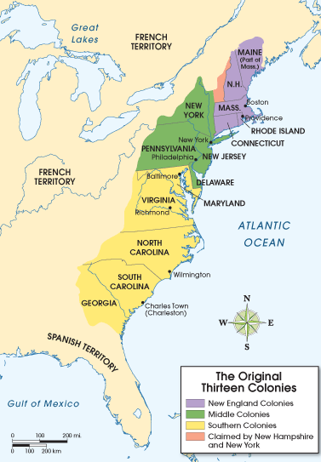
Geography of the Colonies
The Appalachian Mountains acted as a natural boundary between the English Colonies and the French controlled territory to the west.
The Atlantic Ocean served as the eastern boundary to the 13 colonies.
Appalachian Mountains

Slide 4
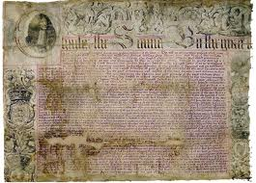
Charter Colony /Proprietary Colony / Royal Colony
A charter is a written contract issued by a government giving the holder the right to establish a colony. (Virginia Company had a charter)
A Proprietary Colony was a charter for a land grant given to an individual. (William Penn)
A Royal Colony was established by a charter, land grant from the king. (James Oglethorpe)
Charter given to William Penn

