Slide 1
13 Colonies
3 Regions: New England Middle Colonies Southern Colonies

Slide 2
Were they all the same?
The 13 colonies were divided into 3 separate regions, the New England Colonies, the Middle Colonies, and the Southern Colonies.
The colonies were grouped by such factors as the climate, resources, and people.

Slide 3
Geography of the Colonies
The Appalachian Mountains acted as a natural boundary between the English Colonies and the French controlled territory to the west.
The Atlantic Ocean served as the eastern boundary to the 13 colonies.
Appalachian Mountains

Slide 4
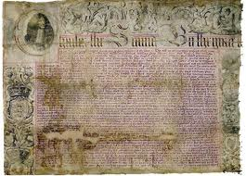
Charter Colony /Proprietary Colony / Royal Colony
A charter is a written contract issued by a government giving the holder the right to establish a colony. (Virginia Company had a charter)
A Proprietary Colony was a charter for a land grant given to an individual. (William Penn)
A Royal Colony was established by a charter, land grant from the king. (James Oglethorpe)
Charter given to William Penn

Slide 5
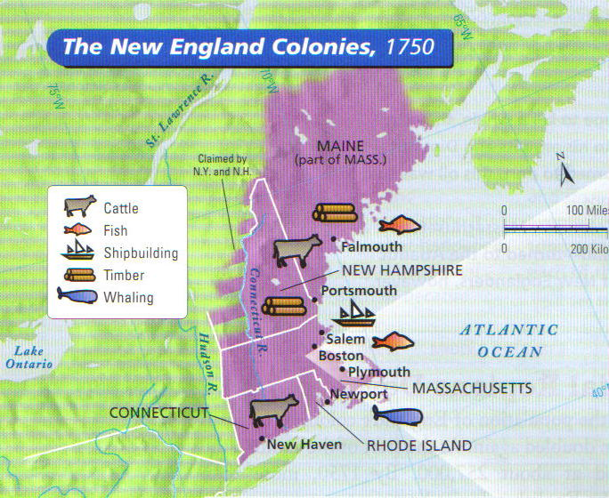
The NEW ENGLAND Colonies
Massachusetts, New Hampshire, Rhode Island & Connecticut

Slide 6
New England Colonies
Climate - bitterly cold winters, mild summers, short growing season
Resources – rocky soil, forested lands, abundant fish
Settlements – small towns, mainly on the coast, created harbors and ports for trade
Economy – shipbuilding, farming, fishing, & part of Triangular Trade
Major Cities - Boston

Slide 7
Subsistence Farming
Most farmers in the New England colonies practiced subsistence farming, meaning they produced just enough food for themselves and sometimes a little extra to trade in town.
Why do you think farmers in the North did not grow cash crops such as tobacco or indigo?

Slide 8
New England Government
Self-Governing Charters
Town Meetings
The Mayflower Compact
The Fundamental Orders of Connecticut
New Hampshire
Massachusetts
Connecticut
Rhode Island

Slide 9
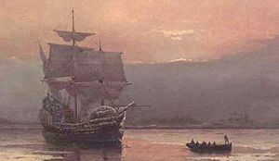
Massachusetts
Plymouth Colony - Founded in 1620 by the Pilgrims (1st Thanksgiving!!).
A religious group that sought to separate themselves from the Church of England became know as Pilgrims. They were persecuted, picked on, because of their beliefs.
Plymouth was the original name of the settlement.
John Carver was the leader of the Pilgrims and author of the Mayflower Compact.
Plymouth Plantation, with Cape Cod Bay visible in the distance.
Mayflower in Plymouth Harbor by William Halsall (1882)

Slide 10
Mayflower Compact
In 1620, 41 men from the Mayflower ship signed a compact promising to write and obey "just and equal laws ... for the general good of the colony."
The compact brought an element of democracy to America and was an example of the practice of self-government in the colonies

Slide 11
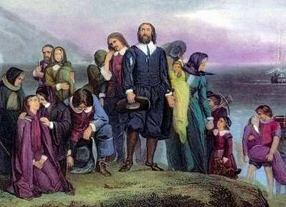
Massachusetts
Puritans then came and settled Boston (Mass. Bay Colony) as a Commonwealth.
John Winthrop (“…a City upon a Hill) was the governor of this settlement.
The Puritans got their name from their belief that they needed to purify the English Church of its rituals.
They were very strict and demanded compliance (agreement) with their rules.

Slide 12
Rhode Island
In 1636, Rhode Island became a colony after Roger Williams, a clergyman, obtained a charter from England to form the colony.
He taught separation of Church and State, meaning that a government should not tell people what religion they should have.
This got him in trouble with the Puritans
Rhode Island also had freedom of religion.
Roger Williams
“minister, author”

Slide 13
Rhode Island
Anne Hutchinson
She taught that people should know the bible for themselves and be in-charge of their own faith.
She believed that church was not necessary for salvation and a personal relationship with God was all that was necessary.
The Puritans accused her of heresy (teaching against the church), brought her to trial, convicted her and banished her.
She joined with Roger Williams to found the Colony of Rhode Island.

Slide 14
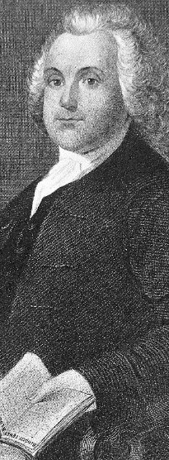
Rhode Island: Separation of Church and State / Equality
Williams and Hutchinson laid the foundations for true religious freedom and the principle of separation of church and state.
Equality of people and freedom of religion was extended to all.
All Christians and Jews were safe.
Rhode Island passed a law to make slavery illegal in 1652. This was the first law against slavery in North America.

Slide 15
Connecticut
Also founded in 1636 by a clergyman Thomas Hooker.
He led a group of people from Rhode Island to start their own colony and they had freedom of religion.
Fundamental Orders of Connecticut – First written Constitution
A map of the Connecticut, New Haven, and Saybrook colonies.

Slide 16
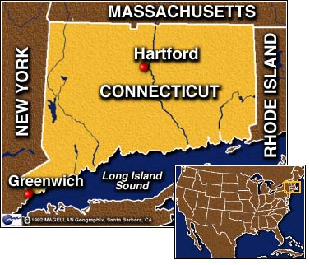
Fundamental Orders of Connecticut
In 1639, men from 3 townships created laws, rules, and orders for how the colony would be ruled
Powers not given to colony, given to towns
Considered the first written constitution in North America. (FC – FC)

Slide 17
New Hampshire
Sold to the king of England in 1679.
Royal colony: king chooses governor and no elected government.

Slide 18
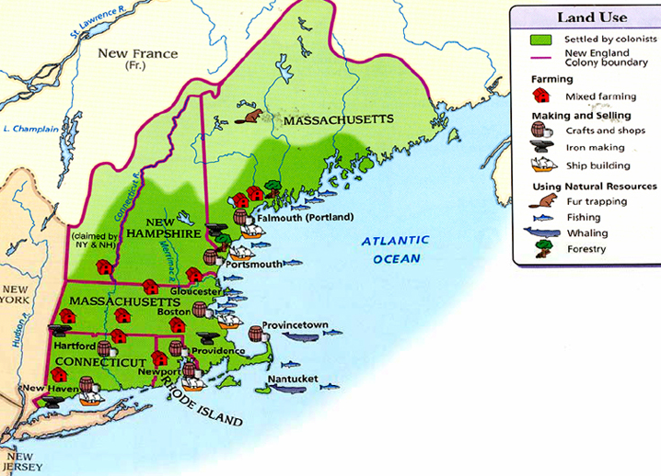
1. What were the key natural resources of New England? 2. How did the geographic factors of the New England influence the economy of the region?

Slide 19
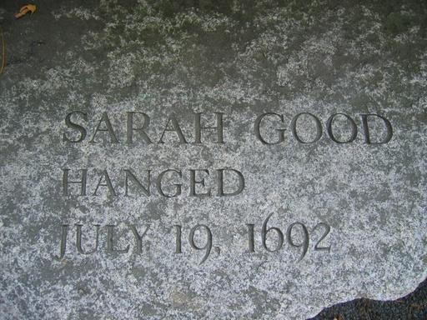
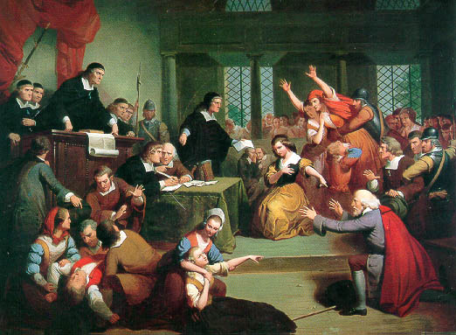
Salem Witch Trials
Puritan New England had changed from being church centered to an atmosphere of fear and suspicion.
Several Salem girls were told frightening stories about witches by a slave named Tituba.
Pretending to be bewitched, the girls falsely accused others of witchcraft, and the witch-hunts began in 1692!
The Puritans viewed the witch-hunts as a sign from God to return to a strict Puritan lifestyle.
Ultimately, more than 100 were arrested and tried with 20 found guilty and put to death.

Slide 20
Evaluate
What contributions to the American Character and the spirit of America did Roger Williams and Anne Hutchinson make?
What was the Mayflower Compact and how did that document contribute to the formation of American democracy and government?

Slide 21
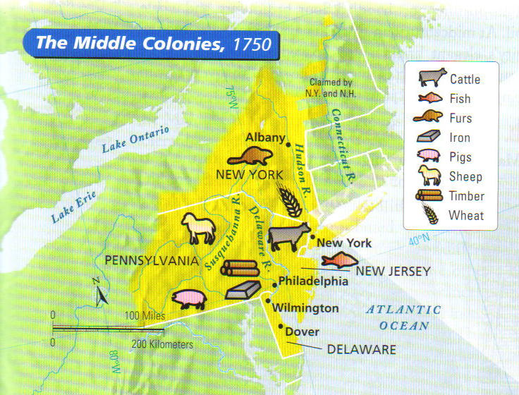
The MIDDLE Colonies
New York, Delaware, New Jersey, Pennsylvania

Slide 22
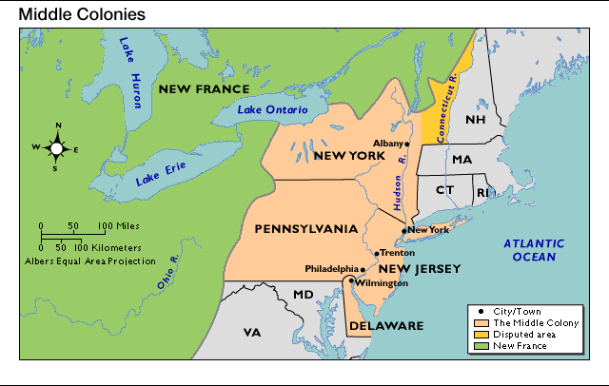
Middle Colonies
Climate – warmer summers=longer growing season
Resources – land for growing cash crops
Settlements - on coast or large rivers, large cities on harbors (New York and Philadelphia)
Economy – cash crops- fruit, vegetables, and grain, produce goods to trade
Major Cities – New York City, Philadelphia

Slide 23
Middle Colonies Government
New York
Proprietary Charters
Religious Freedom and Tolerance
Freedom of the Press
Strong Courts
Pennsylvania
New Jersey
Delaware

Slide 24
New York
Started as New Netherland, a Dutch colony in 1609
James Duke of York was given it from Charles II.
The English took over in 1664 and renamed it New York.
(Breadbasket Colony)
James, Duke of York

Slide 25
The Zenger Trial - 1733
John Peter Zenger – publisher of the New-York Weekly
Criticized the Governor of New York for fixing an election
Zenger was put in jail
At the trial Andrew Hamilton claimed that people had the right to speak (write) the truth
Zenger was set free by the jury
What do you think this set a precedence for?

Slide 26
Pennsylvania
In 1681, William Penn was granted a charter for land between Maryland and New York.
King Charles was in debt to Penn’s father.
Penn was a Quaker and he gave the people two rights:
1. Freedom of Religion
2. Right to elect public officials.

Slide 27
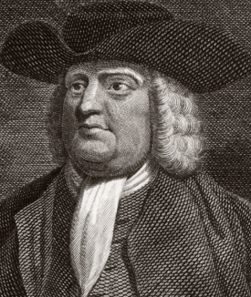
William penn (1644-1718)
Quaker Beliefs
Equality of men and women
Equality of all races and ethnic groups (abolitionists)
True religious tolerance
Non-violent (anti-war)
From a merchant family
A Quaker
Received charter in 1681 to establish Pennsylvania (Penn’s forest).
Penn opened the land to all Quakers

Slide 28
Delaware
In 1682, the Duke of York granted William Penn this land.
It became a colony in 1704.
(Breadbasket Colony)

Slide 29
New Jersey
The Duke of York split this land in half for two friends. (East Jersey & West Jersey)
Government quarrels caused them to be combined in 1702.
(Breadbasket Colony)
Map of New Netherland (17th century)

Slide 30
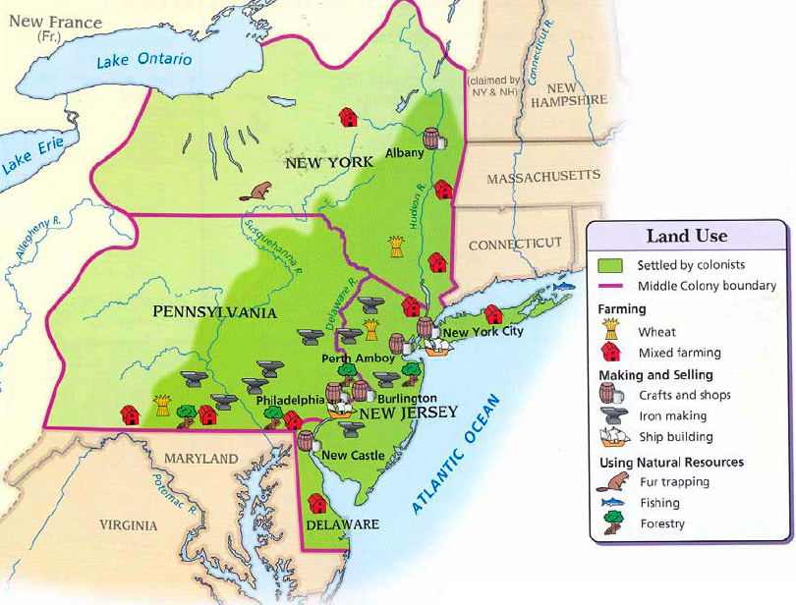
1. What geographic factors would allow the Middle Colonies to develop manufacturing industries?
2. Why do you think New Jersey has the motto, The Garden State?

Slide 31
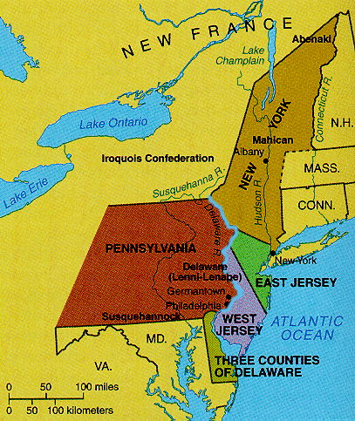
From Dutch to British
The regions of New York, New Jersey, and Delaware were colonies of the Dutch.
The British fought the Dutch and captured the Dutch colonial capital, New Amsterdam in 1664.
New Amsterdam was renamed New York and the British took over the Dutch territories.
1. Why could Albany become a center of trade? 2. Could Philadelphia become a port city? Why? 3. Why were the Middle colonies centers of farming and trade?

Slide 32
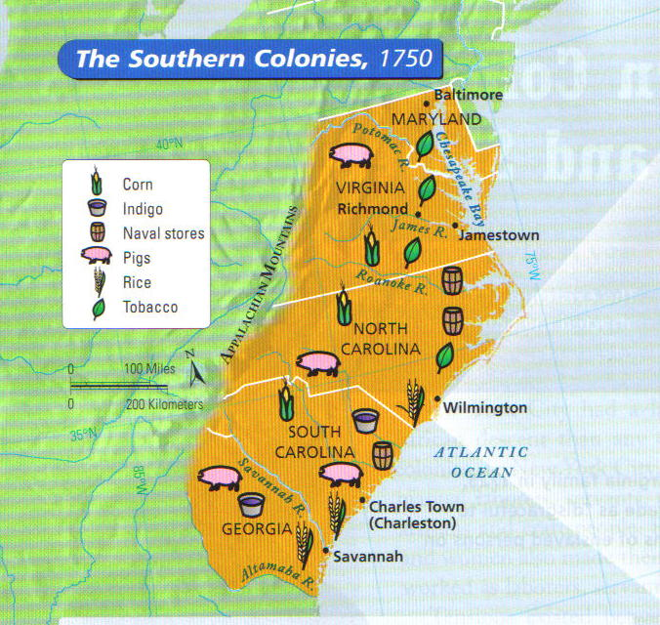
The SOUTHERN Colonies
Virginia, Maryland, N. Carolina, S. Carolina, & Georgia

Slide 33
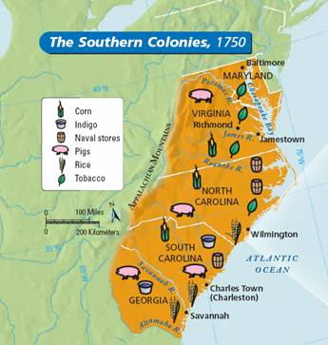
Southern Colonies
Climate – long growing season, warm weather and plentiful rainfall
Resources – rich soil, flat land for large crops
Settlements - mainly on large plantations
Economy – tobacco, rice, indigo, and cotton crops

Slide 34
Southern Colonies Government
Maryland
Virginia
Joint-Stock and Proprietary Charters.
The House of Burgesses
Colonies run for the profit of the Joint-Stock Company or Proprietors.
North Carolina
South Carolina
Georgia

Slide 35
Plantation Economy
Plantations were self-sufficient for the most part. Everything they needed they produced on the plantation. Due to this fact, the large cities that were found in the North were not as easy to find in the South.

Slide 36
Plantation Economy cont’d.
The ability to grow crops year-round made the Southern Colonies an ideal place to grow crops such as rice and tobacco on the large plantation estates.
These crops required a great amount of labor during harvest and many people were needed.
The Southern Colonies turned to the use of slaves from Africa. The Southern Colonies were not the only colonies to use slaves, but used them on a much grander scale than anyone else among the 13 colonies.

Slide 37
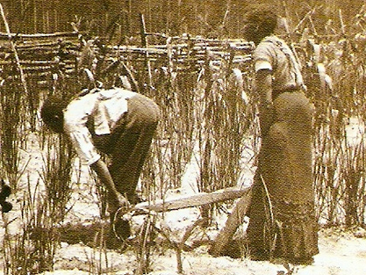
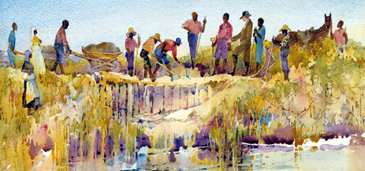
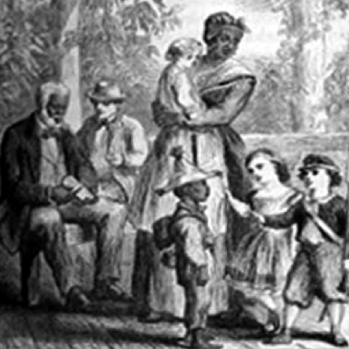
Enslaved Africans Brought Agricultural Knowledge with Them
Rice was introduced into the Southern Colonies by Africans who were experienced growing this crop in Africa.
Many crops that the Africans grew were similar to the crops that could be easily grown in the South.

Slide 38
Maryland
Founded in 1634 by George Calvert who started a charter but didn’t live to see it come true. He believed all people should have religious freedom.
King Charles I was king and didn’t agree with the religious freedom.
In 1649, the Toleration Act was passed that guaranteed equality of rights for everyone for religion.
Southern Colony
George Calvert, Lord Baltimore

Slide 39
Virginia
Founded in 1607 (Jamestown)
Captain John Smith is given credit for starting this colony.
Many people at this time wanted to leave their homeland in order to have more freedoms and to not be under the strict rule of the kings of England.
Southern Colony

Slide 40
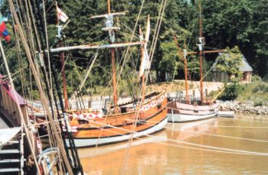
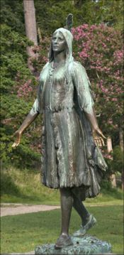
Virginia
A Pocahontas statue was erected in Jamestown, Virginia in 1922
At Jamestown Settlement, replicas of Christopher Newport's 3 ships are docked in the harbor.
Map of Virginia published by John Smith (1612)

Slide 41
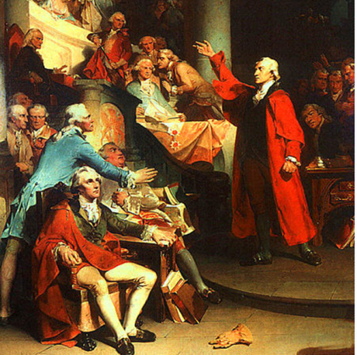
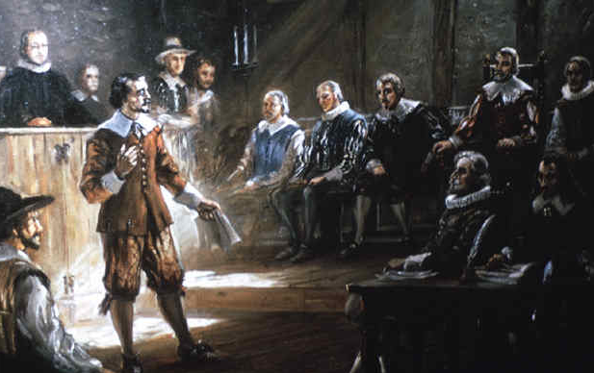
Virginia House of Burgesses, 1619
The word ‘burgess’ was used in England to refer to a person that was elected as a representative from a town.
The English had experience of self-government.
They elected representatives to Parliament.
A big change happened in Virginia in 1619.
The villages elected representatives that would meet to make local laws and decisions.
This legislative (law-making group) was called The Virginia House of Burgesses.
House of Burgesses—1st Legislature, House of Congress, in the English Colonies!

Slide 42
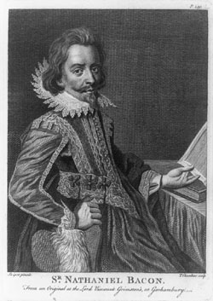
Bacon’s Rebellion - 1676
By the 1670s, ¼ of the free white men were former indentured servants.
These colonists did not own land and lived mostly on Virginia’s western frontier, where they battled the Native Americans for land.
Nathanial Bacon and others opposed the Governor about high taxes and his favoritism toward wealthy plantation owners.
Bacon demanded a war against the Natives to seize their land for tobacco plantations, but the Governor refused, sparking Bacon’s rebellion.
Bacon marched into Jamestown, took control of the House of Burgesses and burned Jamestown to the ground.
Bacon unfortunately became ill and died shortly thereafter leading to the end of the rebellion.
The House of Burgesses passed laws after this rebellion to prevent a royal governor from assuming such power again.

Slide 43
North Carolina
Founded in 1663 by English nobles.
Charter granted by Charles II.
Charleston: main city was named after Charles II. Became very important port city.
Bad politics forced a split of the colony into North and South.
Southern Colony
King Charles II

Slide 44
South Carolina
In 1729 South Carolina received its name after a political dispute and became a colony.
Had large plantations for growing crops and raising livestock.
Southern Colony

Slide 45
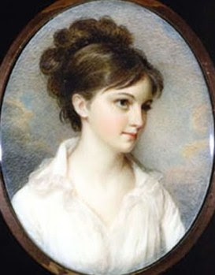
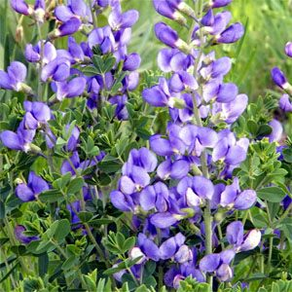
South Carolina
Eliza Lucas Pickney is credited with developing indigo as a cash crop first on her family’s plantation in South Carolina and then throughout the South.

Slide 46
Georgia
It became a colony in 1733.
James Oglethorpe was granted a charter to start Georgia for the poor and unfortunate who leave prison.
It was known as a buffer zone between the Spanish and the English colonies.
Southern Colony

Slide 47
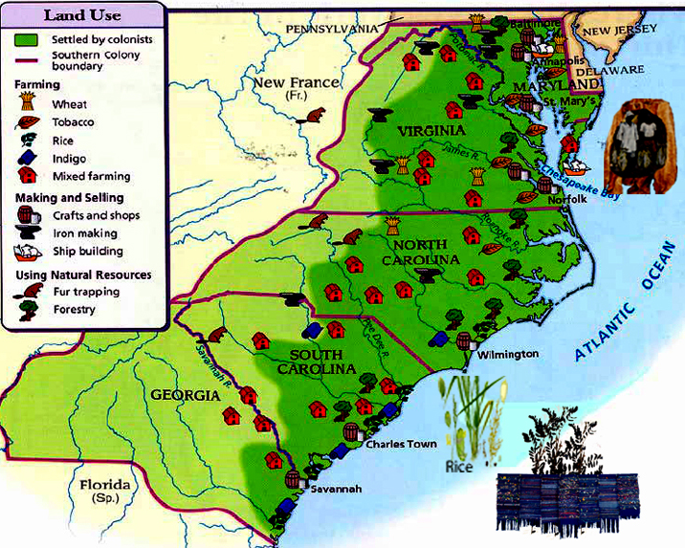

Slide 48
13 Colonies
Which region had a colony created for a different reason than the others?

Slide 49
Interpret
Which of the colonial regions would be the most likely to be dependent upon trade with England? Why? Cite your evidence.
Which of the colonial regions, New England, Middle, or Southern, would most likely have an economy that was independent from England? Why? Cite your evidence.

Slide 50
Triangular Trade
This was the name given to a trading route with 3 stops.
For example, a ship might leave New England with a cargo of rum and iron.
In Africa, the captain would trade his cargo for slaves.
Slaves then endured the horrible “Middle Passage” to the West Indies, where they were exchanged for sugar and molasses.
Traders then took the sugar and molasses back to New England. There colonists used the molasses to make rum, and the pattern started over.

Slide 51
Triangular Trade Route

Slide 52
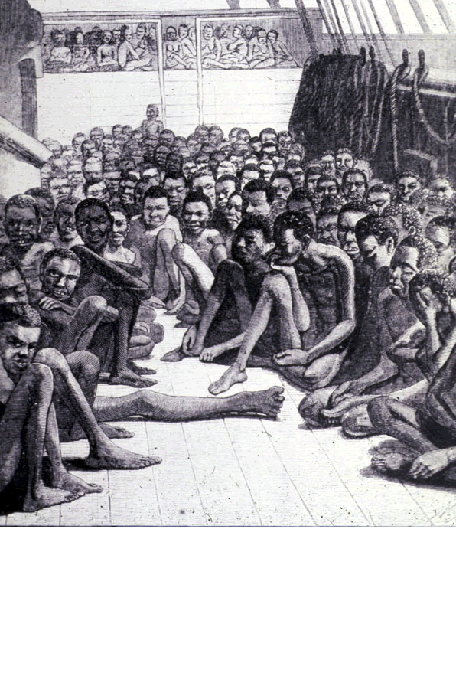
“Middle Passage”

Slide 53
Navigation Acts
New England made enormous profits from trade and England wanted to make sure that it received part of those profits.
As a result the Navigation Acts were passed in 1651, and had 4 major parts to make sure England made money from its colonies’ trade. (Mercantilism)
All shipping done in English ships or ships made in English colonies.
Products such as tobacco, wood, and sugar could be sold only to England or its colonies.
European imports to the colonies had to pass through English ports.
English officials were to tax and colonial goods not shipped to England.
Why would this law anger merchants and colonists in the 13 colonies? How do you think the reacted to the passage of the Navigation Acts?

Slide 54
Smuggling & Pirates
As one might expect, England had trouble controlling colonial shipping from thousands of miles away.
Merchants ignored the acts whenever possible.
Smuggling, importing or exporting goods illegally, was very common.
Pirates were popular and common at this time, attacking colonial ships.
The most famous pirate of the time was Blackbeard!

Slide 55
Great Awakening

Slide 56
Enlightenment

