Slide 1
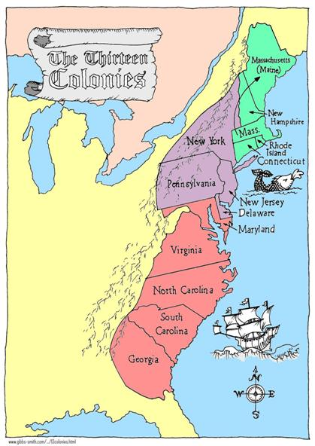
13 Colonies
3 Regions: New England Middle Colonies Southern Colonies

Slide 2
Were they all the same?
The 13 colonies were divided into 3 separate regions, the New England Colonies, the Middle Colonies, and the Southern Colonies.
The colonies were grouped by such factors as the climate, resources, and people.

Slide 3
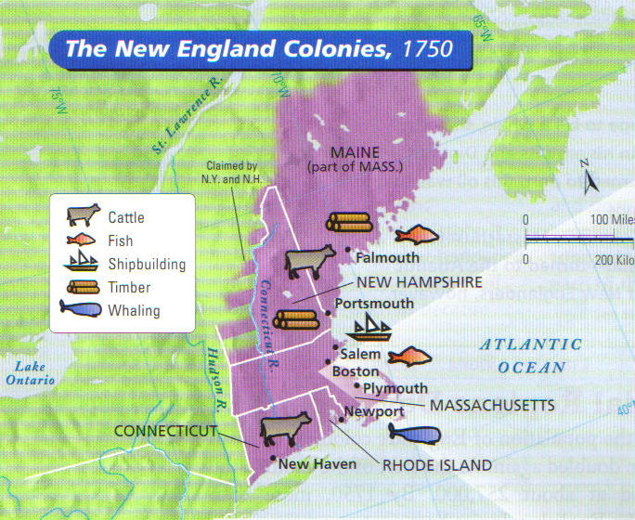
The NEW ENGLAND Colonies
Massachusetts, New Hampshire, Rhode Island & Connecticut

Slide 4
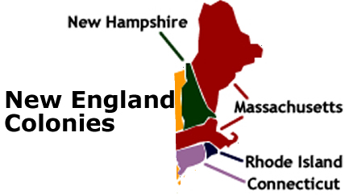
New England Colonies
Climate - bitterly cold winters, mild summers, short growing season
Resources – rocky soil, forested lands, abundant fish
Settlements – small towns, mainly on the coast, created harbors and ports for trade
Economy – shipbuilding, fishing, & part of Triangular Trade

Slide 5
New England Government
Self-Governing Charters
Town Meetings
The Mayflower Compact
The Fundamental Orders of Connecticut
New Hampshire
Massachusetts
Connecticut
Rhode Island

Slide 6
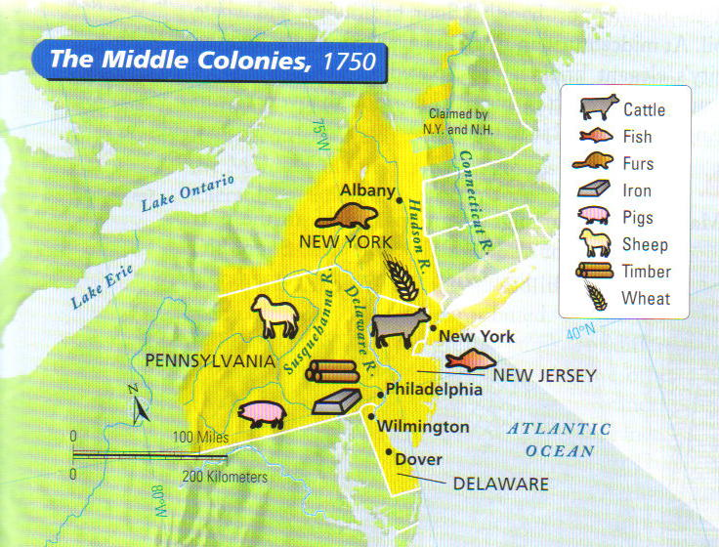
The MIDDLE Colonies
New York, Delaware, New Jersey, Pennsylvania

Slide 7
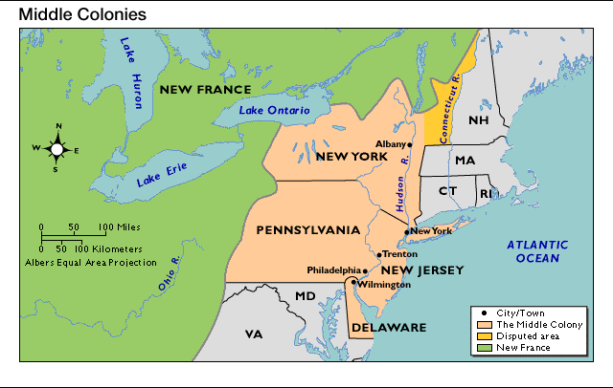
Middle Colonies
Climate – warmer summers=longer growing season
Resources – land for growing cash crops
Settlements - on coast or large rivers, large cities on harbors (New York and Philadelphia)
Economy – cash crops- fruit, vegetables, and grain, produce goods to trade

Slide 8
Middle Colonies Government
New York
Proprietary Charters
Religious Freedom and Tolerance
Freedom of the Press
Strong Courts
Pennsylvania
New Jersey
Delaware

Slide 9
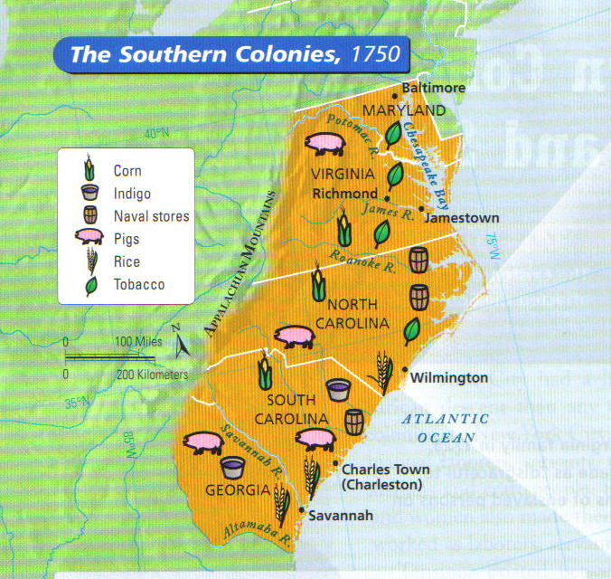
The SOUTHERN Colonies
Virginia, Maryland, N. Carolina, S. Carolina, & Georgia

Slide 10
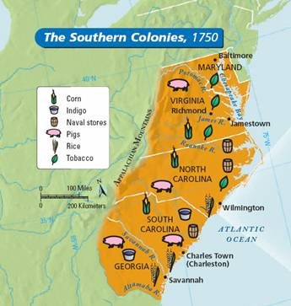
Southern Colonies
Climate – long growing season, warm weather and plentiful rainfall
Resources – rich soil, flat land for large crops
Settlements - mainly on large plantations
Economy – tobacco, rice, indigo, and cotton crops

Slide 11
Southern Colonies Government
Maryland
Virginia
Joint-Stock and Proprietary Charters.
The House of Burgesses
Colonies run for the profit of the Joint-Stock Company or Proprietors.
North Carolina
South Carolina
Georgia

